Slide 1


MSc Petroleum Engineering
Project presentation
Artem Potlog
Depositional facies prediction using machine learning
Heriot-Watt University
School of Energy Geoscience Infrastructure and Society
Institute of GeoEnergy
Prof. Vasily Demyanov
Farah Rabie

Slide 2
outline
Problem statement 3
Data 5
Workflow and methods 11
Clustering 14
Classification 25
Conclusions and future work 36
2
Notes:
The outline proposes the structure on your talk. At the moment, the structure is not there yet. Right? It's just a flow of slides. undefined (39:42 - 40:01): The outline splits, and you have the structure. So the structure is you start with the problem statement, and you show the data, you demonstrate, you have a section of the data which demonstrates that the data is sparse, the data are uncertain, the data availability is limited. undefined (40:02 - 40:19): It's slide five, right? Data availability. And then you show, okay, I'm going to do two things. I'm going to answer two questions about how many faces are there, prompted by the data, and I will go and predict those faces, right? undefined (40:19 - 40:32): And then I will run a number of experiments and conclude. So that's your simple outline. And that outline would separate your 20 slides into meet five sections, five or six sections. undefined (40:33 - 40:45): Okay? So you need to fix that. Just one question. Yes.

Slide 3
Problem statement
Manual picks from wireline logs
Different cut-offs & mental rules
Heterogeneous log suites/quality
Hard labels hide uncertainty
Inconsistent labels lead to biased volumes/forecasts
Slow, hard to QC
Problem: Develop and evaluate ML workflow that predicts depositional facies from logs.
Approach: Unsupervised clustering to find the number of facies; supervised classification predict depo. facies
3

Slide 4
Problem statement
Manual picks from wireline logs
ML workflow
Different cut-offs & mental rules
Heterogeneous log suites/quality
Hard labels hide uncertainty
Inconsistent labels lead to biased volumes/forecasts
Slow, hard to QC
Unsupervised clustering: estimate # of groups; spot overlaps/outliers
Supervised classification: per-class probabilities
Consistent, probabilistic facies picks
Explicit uncertainty for QC and re-interpretation
Problem: Develop and evaluate ML workflow that predicts depositional facies from logs.
Approach: Unsupervised clustering to find the number of facies; supervised classification predict depo. facies
4

Slide 5
data
5

Slide 6
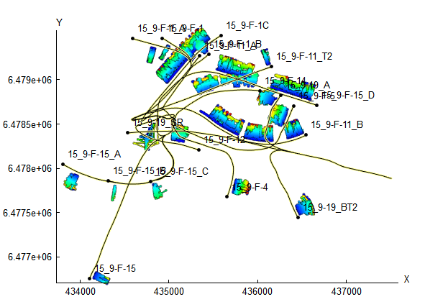
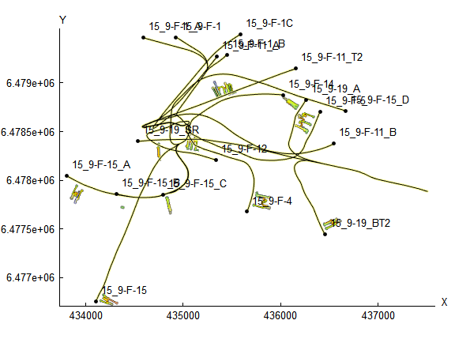

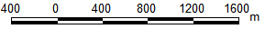
Data is sparse
Across Volve field wells (Equinor public data set) log coverage is heterogeneous, some curves are missing or partial, core control is scarce.
This uneven coverage produces ambiguous labels and uncertainty that originates in the data
Logs
Depositional facies
6

Slide 7
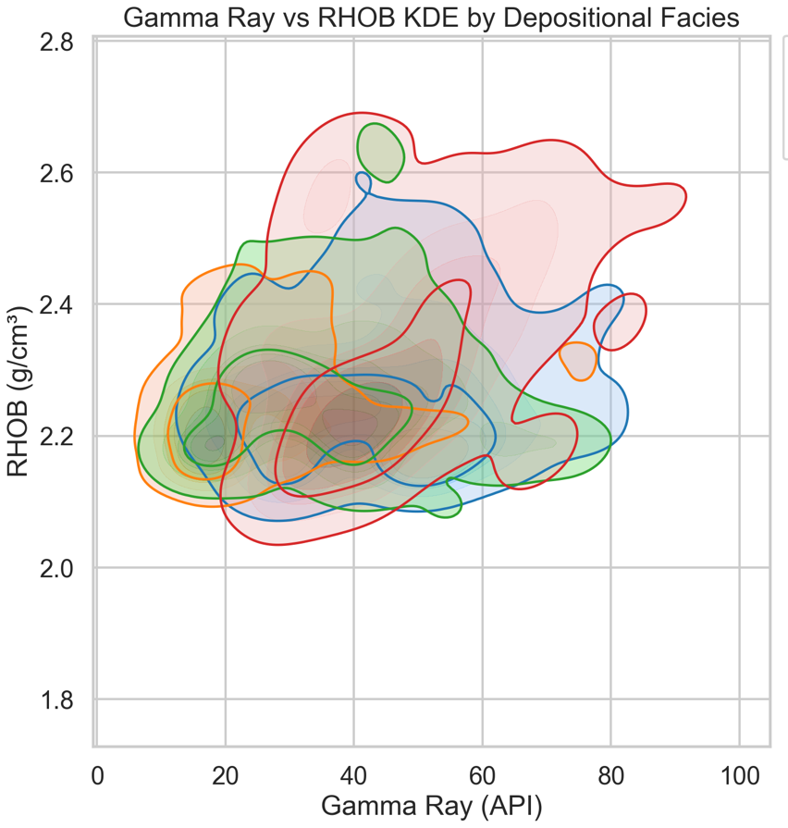
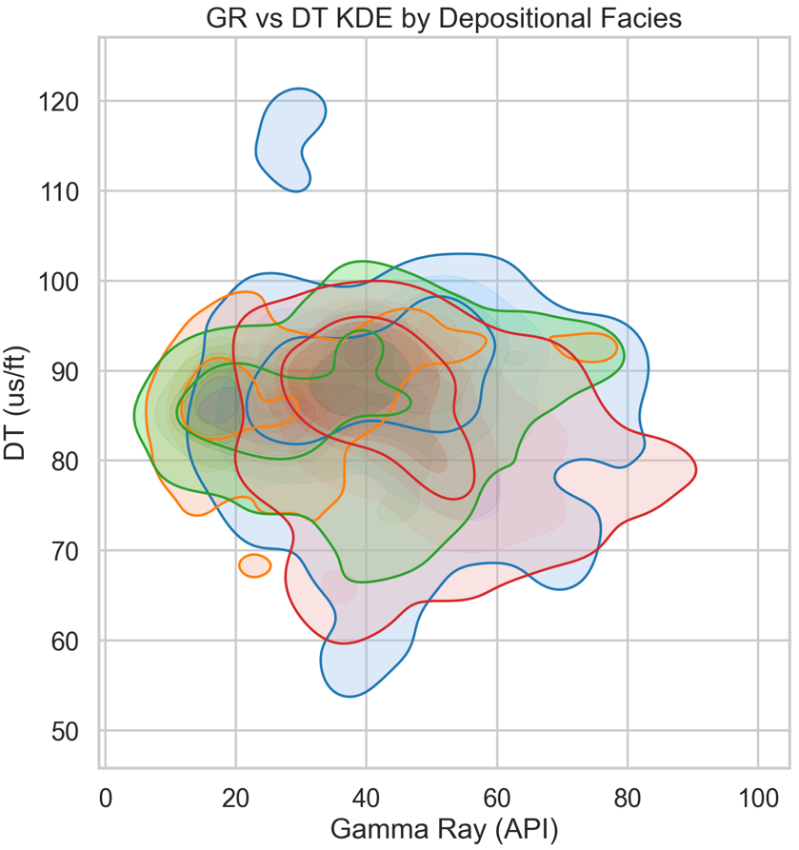
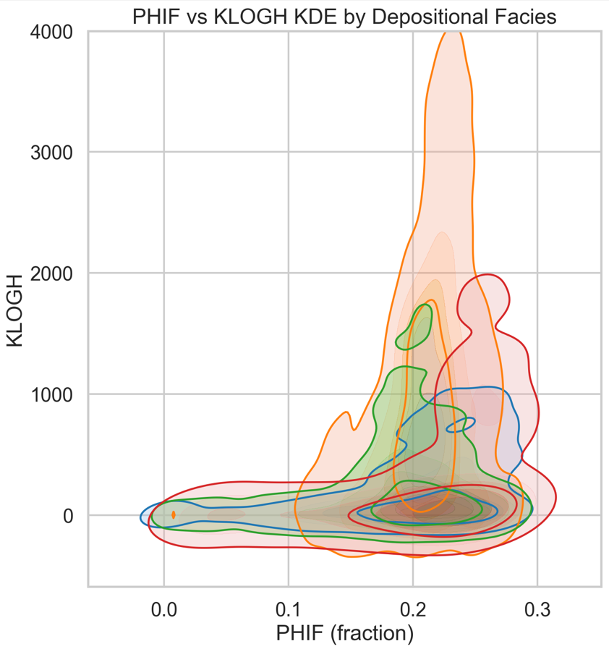
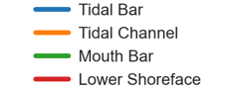
Log cross-plots strongly overlap
We plotted different logs on cross-plots based on depo. facies and see a strong overlap in all pairs. Same combination can appear facie or another –> part of the uncertainty comes from the logs. For ML this means limited cluster separability
7

Slide 8
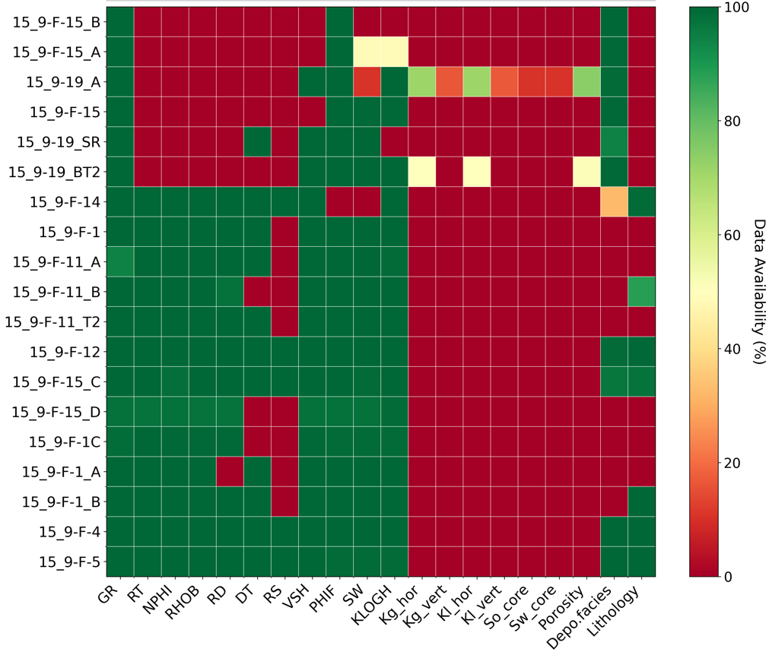
Data scarcity
Inputs:
logs;
log-derived curves;
9 depo. facies;
6 lithology labels.
For modelling we use wells with consistent depo. facies vs logs picks
!
!
logs
log-derived
core
8
lithology and facies labels

Slide 9
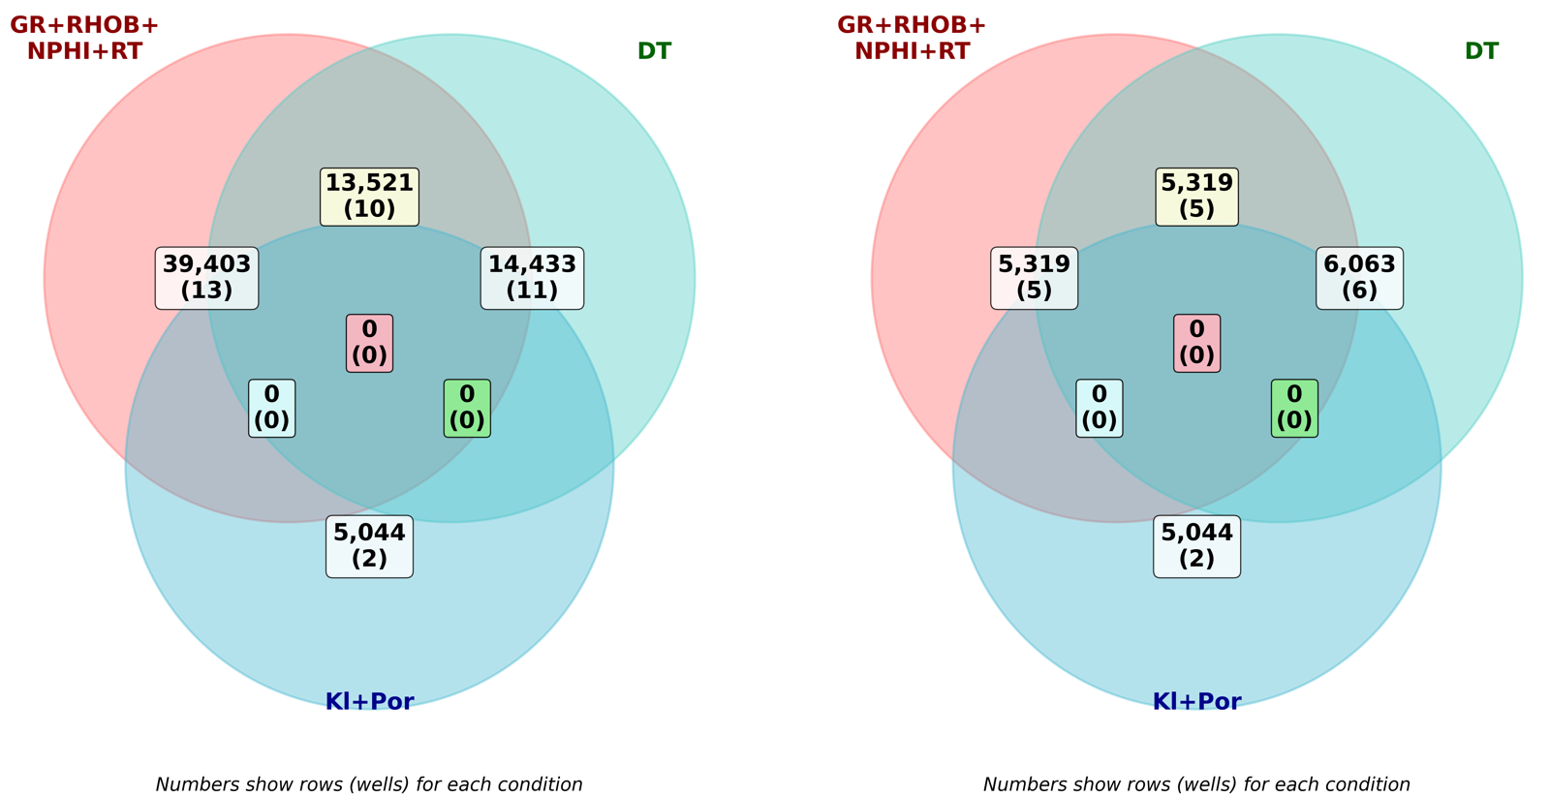
Litho and depo facies labels are limited
9
5k samples in 5 wells (out of 19) are available for unsupervised validation and supervised learning.
In the project we also test different log combinations sacrificing informativeness (less logs) but increasing available samples.
Without depo. facies and lithology labels
With depo. facies and lithology labels
9
1
2
3

Slide 10
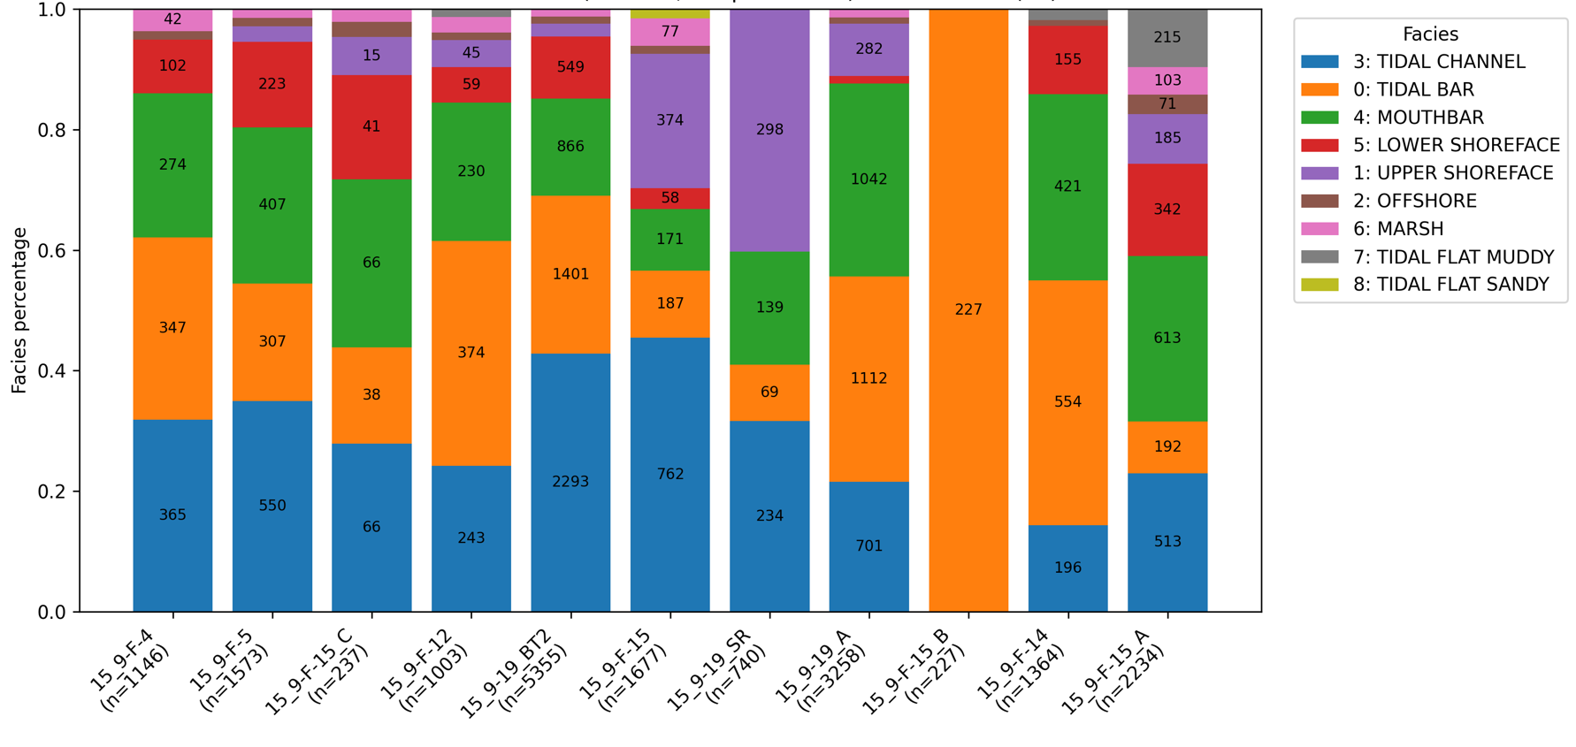
Wells pick for training/testing dictated by facies representation
Not all wells available for supervised learning have a good representation of depo. facies, which dictates wells pick for training/testing purpose
Well F-5 (or 15_C) is used for testing purpose
Wells F-4, 15_C, F-12, BT2 – training wells
Train well
Test well
Train well
Train well
Train well
Wells available for supervised learning
All wells with depositional facies labels
10

Slide 11
Workflow and methods
11

Slide 12
Workflow and methods
Clustering to separate the logs into groups and study if these groups are meaningful;
Classification to predict depositional facies facies
Clustering
Classification
Algorithm: K-means.
Cluster Selection (k): Silhouette score and Elbow chart.
Interpretation: Principal Component
Validation: Against known depositional facies
Algorithm: Random Forest
Protocol: Training on wells with strong facies representation, testing on held-out wells.
Metrics: Accuracy, Precision, Recall, f1
12

Slide 13
Workflow and methods
Clustering to separate the logs into groups and study if these groups are meaningful;
Classification to predict depositional facies facies
Data preprocessing
Clustering
Classification
Input Features: logs, log-derived values, lithology
Engineered Features: GR Slope, GR Serration, relative position.
Transformations and scaling
KNN imputation for missing values
Categorical lithology one-hot encoded.
Algorithm: K-means.
Cluster Selection (k): Silhouette score and Elbow chart.
Interpretation: Principal Component
Validation: Against known depositional facies
Algorithm: Random Forest
Protocol: Training on wells with strong facies representation, testing on held-out wells.
Metrics: Accuracy, Precision, Recall, f1
13

Slide 14
clustering
14

Slide 15
Clustering objective
Explore structure with clustering. Use unsupervised methods to estimate the number of groups and compare clusters with known facies to spot overlaps and label noise.
15

Slide 16
Question 1
Why
1. How clustering separate groups? (Do classes form natural groupings?)
Reveal natural splits and set target granularity
16

Slide 17
Question 2
Why
2. How similar or different are these groups?
What drives separability
17

Slide 18
Question 3
Why
3. How interpretable are the groups with respect to depositional facies?
Ensure clusters map to geology, not just numerical groupings
18

Slide 19
Clustering experiments
Questions
Why
Experiments
1. How clustering separate groups? (Do classes form natural groupings?)
Reveal natural splits and set target granularity
Run in different feature sets to study log informativeness, k results, Principal components, confusion matrices
2. How similar or different are these groups?
What drives separability
3. How interpretable are the groups with respect to depositional facies?
Ensure clusters map to geology, not just numerical groupings
19

Slide 20
Four clustering experiments outline
Feature set is: 1) all logs; 2) all logs without fluids; 3) porosity/sorting logs; 4) cleanliness/porosity logs
Experiments
Why
1. All logs: GR, VSH, RT, RD, NPHI, RHOB, DT, PHIF, SW, KLOGH
Broadest view of variance
2. All without fluids: GR (and/or VSH), NPHI, RHOB, DT, PHIF, KLOGH
To emphasize rock property space (cleanliness, porosity/sorting, mobility proxy) and de-emphasize fluids
3. Porosity/sorting only: DT, RHOB, NPHI
Check whether groups emerge purely from sorting/porosity differences
4. Cleanliness and porosity: VSH, DT, PHIF (or NPHI and RHOB)
Designed to highlight clean, well-sorted sands versus heterolithic sands
20

Slide 21
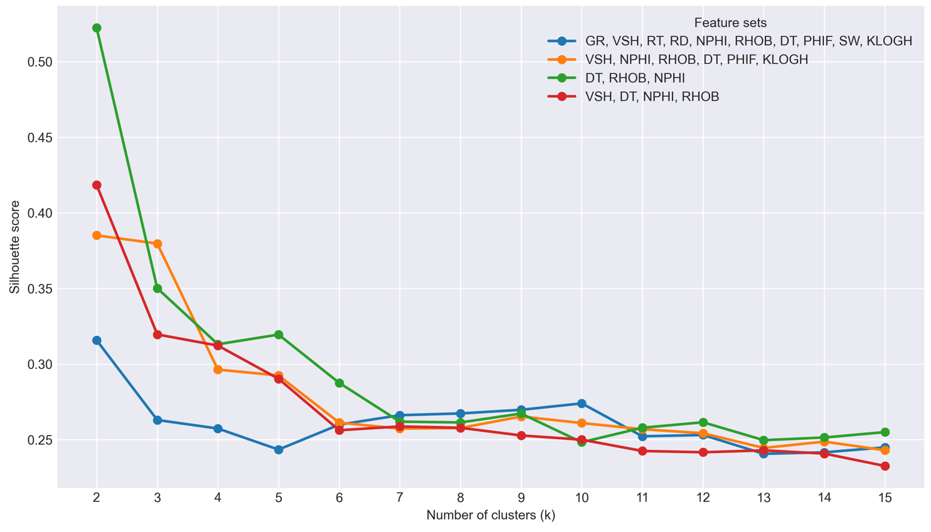
How clustering separate groups, how similar they are?
Silhouette score shows that logs form two natural clusters driven by rock properties: clean/porous vs shaly/compact. Beyond two clusters depositional facies do not form distinct natural groupings
1. All logs:
fluid variability cuts across depositional patterns and weakens unsupervised separation.
2. VSH, NPHI, RHOB, DT, PHIF, KLOGH: third, moderate flow-quality mode appears when permeability is added. But sand vs sand distinction remains blended
3. DT, RHOB, NPHI: very clear binary clean-shaly split
4. VSH, DT, NPHI, RHOB: in spaces dominated by porosity/compaction vs cleanliness, the data separate into clean sand vs shaly/tight
21

Slide 22
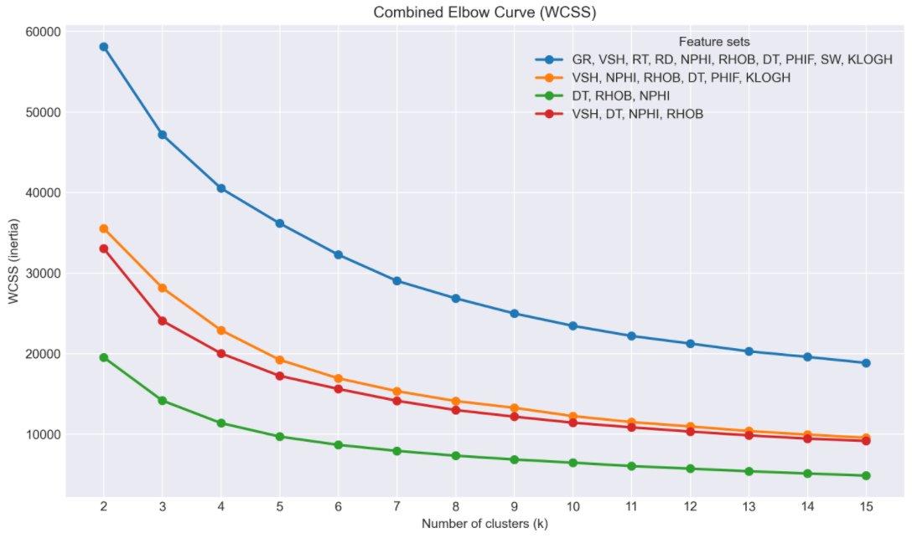
How clustering separate groups, how similar they are?
From the elbow curve we see that logs without fluids show 2-3 clusters at best
1. All logs
2. VSH, NPHI, RHOB, DT, PHIF, KLOGH
3. DT, RHOB, NPHI
4. VSH, DT, NPHI, RHOB
22

Slide 23
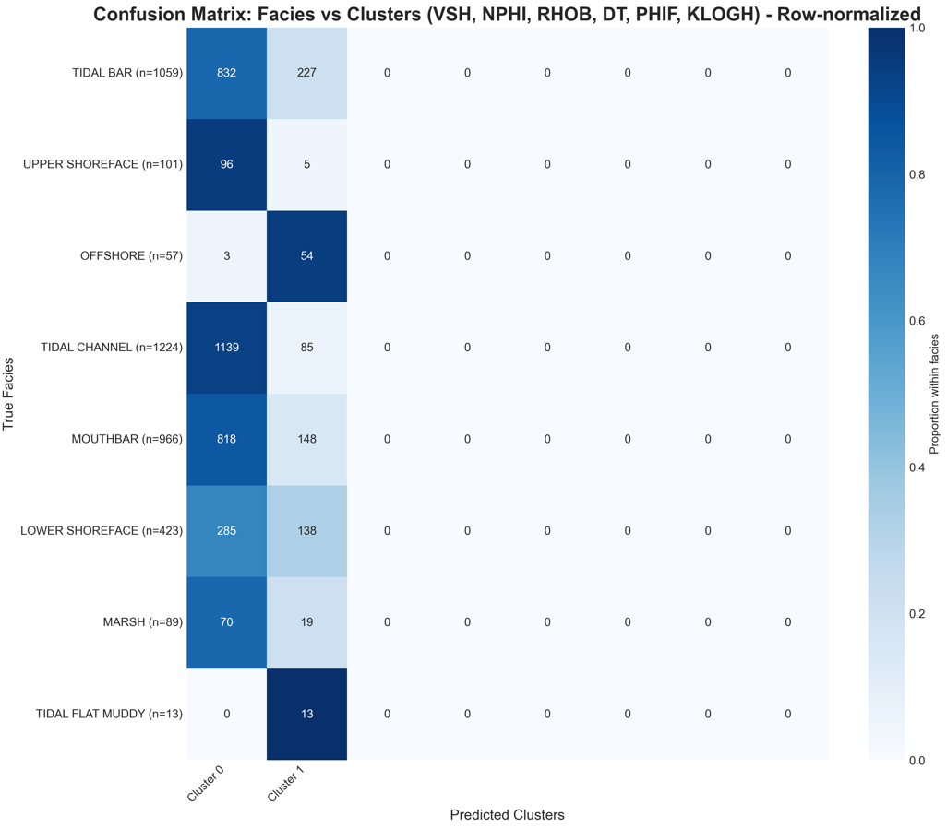
How interpretable are the groups?
k = 2, VSH, NPHI, RHOB, DT, PHIF, KLOGH
Clusters are geologically interpretable at a coarse level: clean sand vs shaly separation.
On the confusion matrices for k = 2 one cluster concentrates most sand depo. facies (Tidal Bar, Tidal Channel, Mouth Bar, Upper Shoreface), while other captures shaly depo. facies (Offshore, Tidal Flat Muddy).
23

Slide 24
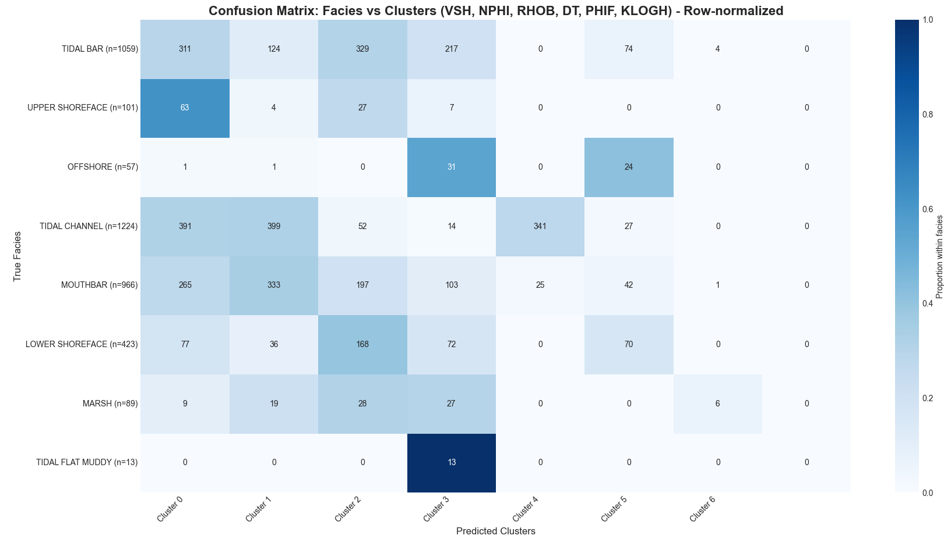
How interpretable are the groups?
k = 7, VSH, NPHI, RHOB, DT, PHIF, KLOGH
Increasing number of clusters leads to a poor separation: facies spread across several clusters
24

Slide 25
classification
25

Slide 26
Classification objective
Train supervised models to predict depositional facies; use per-well blind tests to check generalization across wells; optimize accuracy
26

Slide 27
question 1
Why
1. Do different feature sets change performance?
Find which log combinations carry separable signal; quantify trade-offs; test if fluids help beyond porosity/cleanliness.
27

Slide 28
question 2
Why
2. Does adding a lithology feature help?
Lithology narrows classes and should reduce sand vs sand confusion.
28

Slide 29
question 3
Why
3. Do engineered features help?
Geology-aware features can surface motifs important in Hugin’s tide-influenced sands
29

Slide 30
Classification experiments
Questions
Why
Experiments
1. Do different feature sets change performance?
Find which log combinations carry separable signal; quantify trade-offs; test if fluids help beyond porosity/cleanliness.
Run in different feature sets
2. Does adding a lithology feature help?
Lithology narrows classes and should reduce sand vs sand confusion.
For best performing add Lithology
3. Do engineered features help?
Geology-aware features can surface motifs important in Hugin’s tide-influenced sands
For best performing w/ Lithology add engineered features
30

Slide 31
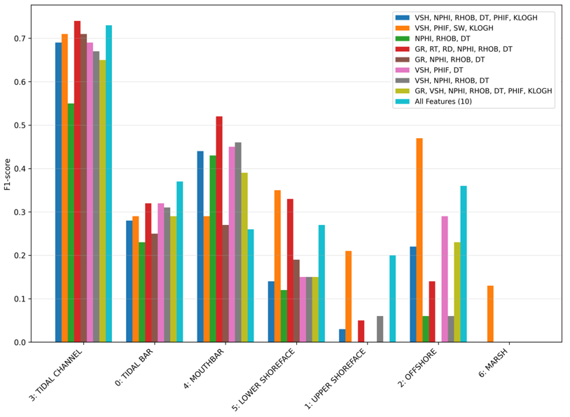
Do different feature sets change performance?
Presented are results f1-score per-facie for 9 different features combinations we ran.
Results: Feature set choice materially changes performance; gains come from combining porosity + cleanliness + fluids
Addition of KLOGH and PHIF introduces better performance in minority classes (higher macro-f1)
31

Slide 32
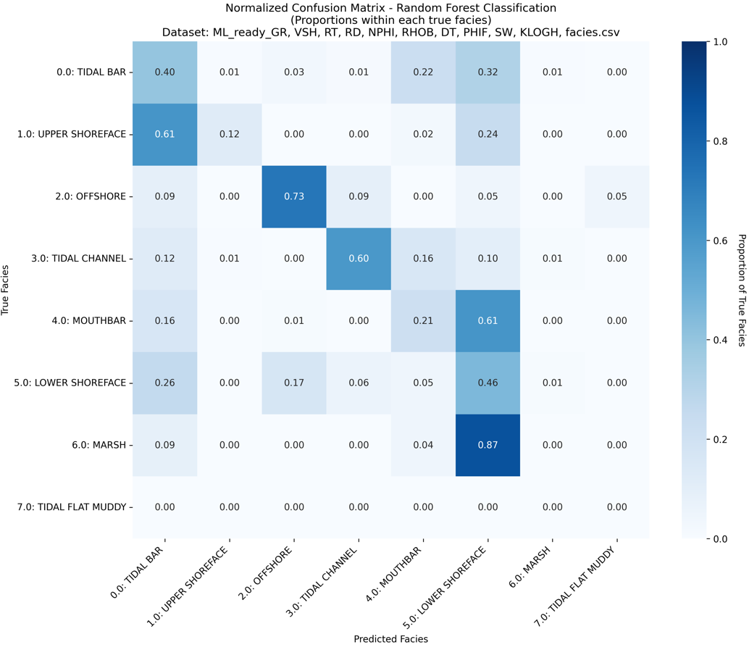
Most confused classes
All logs set Confusion matrix
In the best performing case most confused pairs of sand vs sand facies:
Tidal Bar vs Mouth Bar
Tidal Bar vs Lower Shoreface
Mouth Bar vs Lower Shoreface
Tidal Channel vs Mouth Bar
Upper shoreface vs Tidal Bar
These results motivate adding lithology and engineered context features to tackle sand vs sand ambiguities and confusion
32

Slide 33
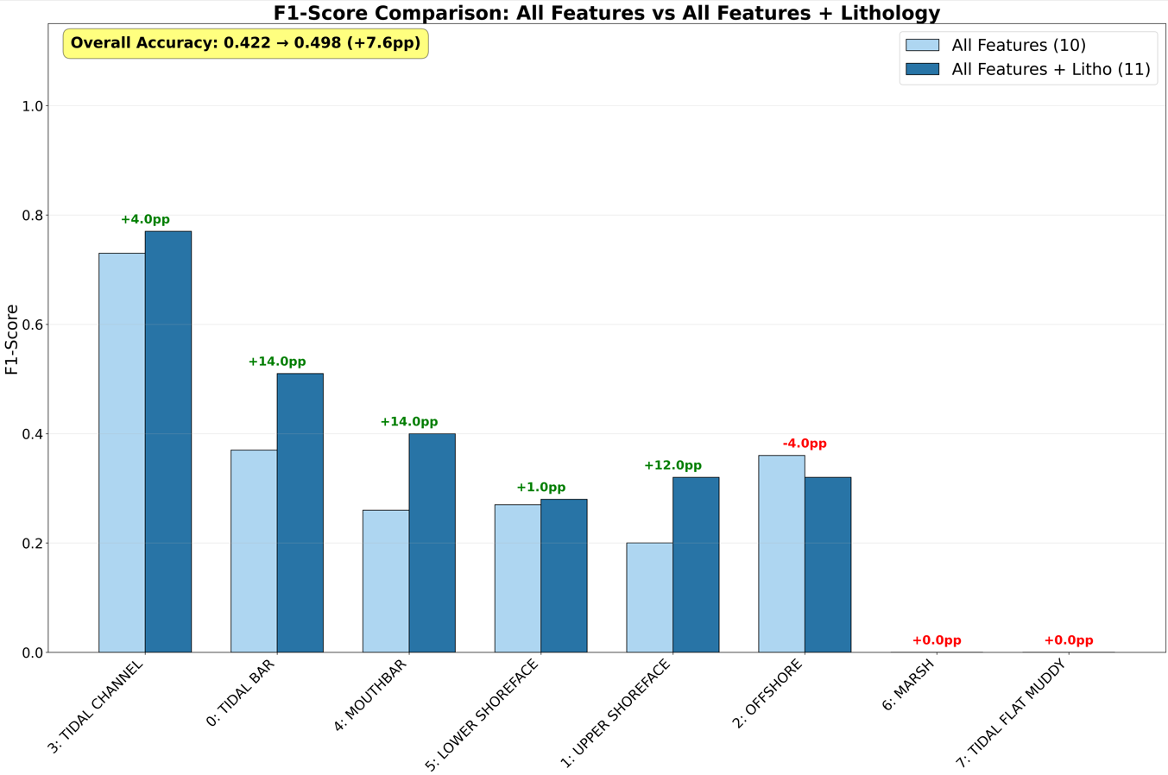
Does adding a lithology feature help?
Addition of lithology significantly improved overall and per-facie prediction accuracy
Sand vs sand confusion across problematic pairs also significantly improved
33

Slide 34
engineered features experiments outline
Engineered features aimed to add geological context which may improve model performance by decreasing confusion among sand vs sand depofacies
Experiments
Why
GR slope: d(GR)/dz in 3 m window
To capture coarsening up (Mouth Bar) vs fining up (Tidal Bar, Tidal Channel)
GR serration: rolling σ(GR) in 3 m window
GR Serration is higher in heteroliths/mud-draped tidal bars
RelPos (relative position in GR cycle)
Help distinguish sands in regressive-transgressive cycles
34

Slide 35
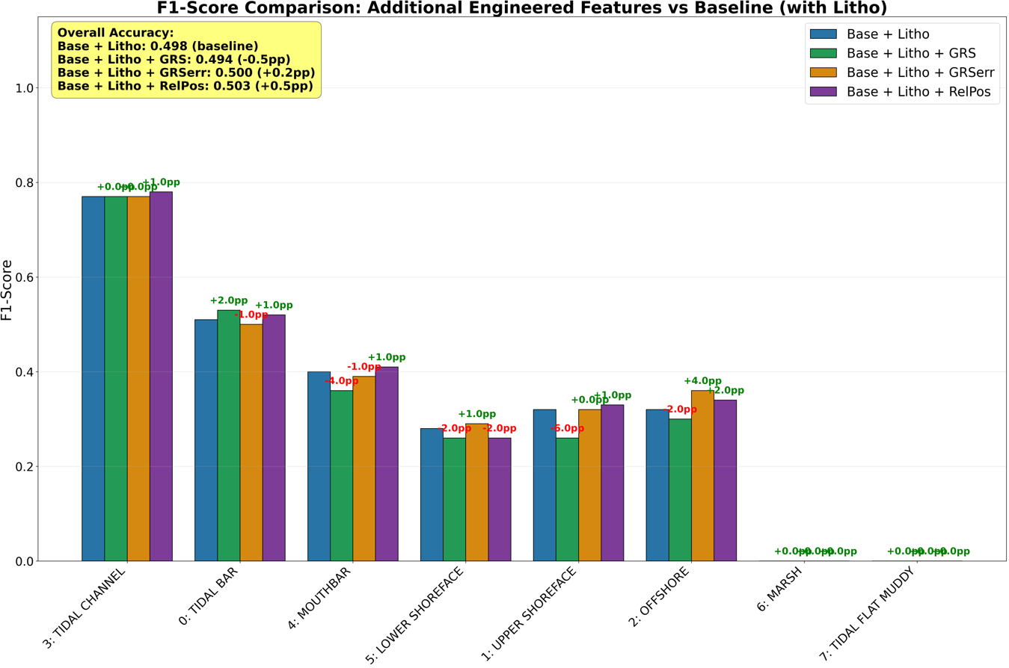
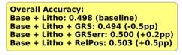
Do engineered features help?
Geology-aware engineered features add small but real gains (+small accuracy; + 1pp macro f1) by injecting texture and stacking context that raw logs miss.
Among them, RelPos is the most consistent, giving the best overall lift and slightly reducing sand vs sand ambiguity.
35
Notes:
Serration worked in the classes where it is expected (Offshore, lowershoreface), but lost in blocky sands

Slide 36
conclusion
36

Slide 37
conclusion
What worked
Limitations and challenges
Value
Clustering separates clean sand vs shaly/tight: good for scoping/QC.
Classifier better predicts depo. facies with all features including fluids.
Lithology boosted accuracy and decreased sand vs sand confusion.
Engineered features mimic geological features and slightly increase accuracy, can address class imbalance.
Persistent Tidal Bar vs Mouth Bar vs Lower Shoreface confusion.
Minority facies under-learned.
Engineered features impact is modest.
Faster, more consistent depo. facies picks.
Lightweight workflow with clear diagnostics.
37

Slide 38
Future work
Tackle imbalance and focus on confused pairs.
Integrate core-derived features.
Two-stage pipeline: impute missing logs (RF regressor) and use predictions as features.
Tune engineered features.
38

Slide 39
Back-up slides
39

Slide 40
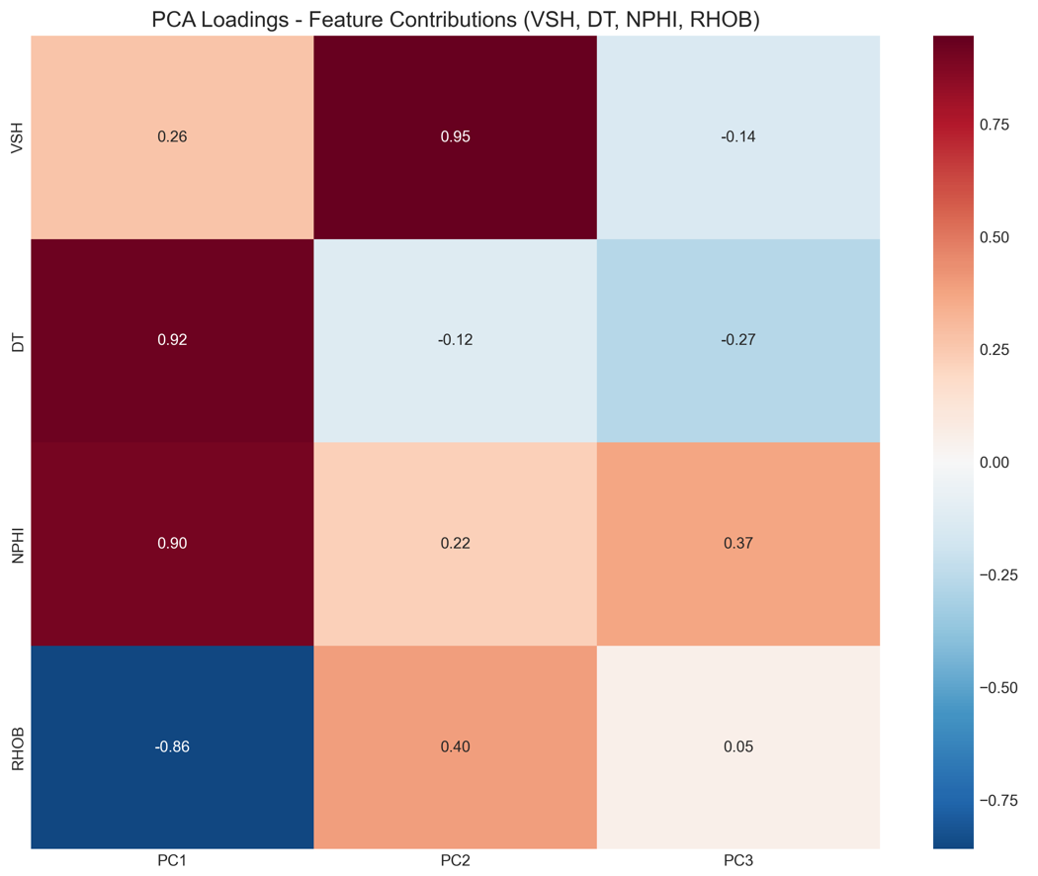
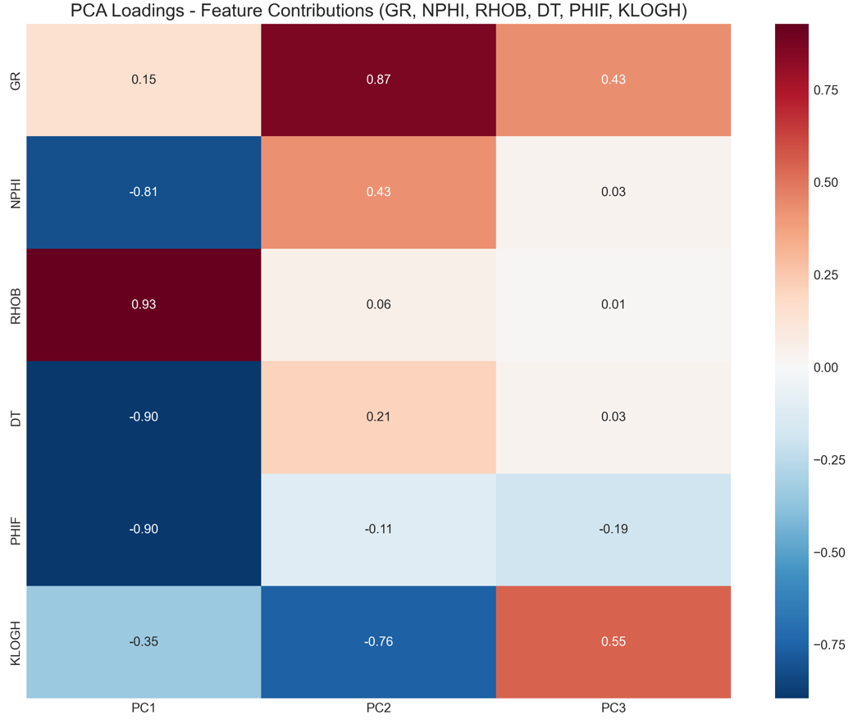
question 2 experiments result
Two groups are tight and distinct in rock-property spaces.
PCA loadings plots show that Clustering at best separate porous & clean vs tight and clean vs shaly.
This is not enough for sand vs sand separation
VSH, DT, NPHI, RHOB
VSH, DT, NPHI, RHOB, KLOGH
40

Slide 41
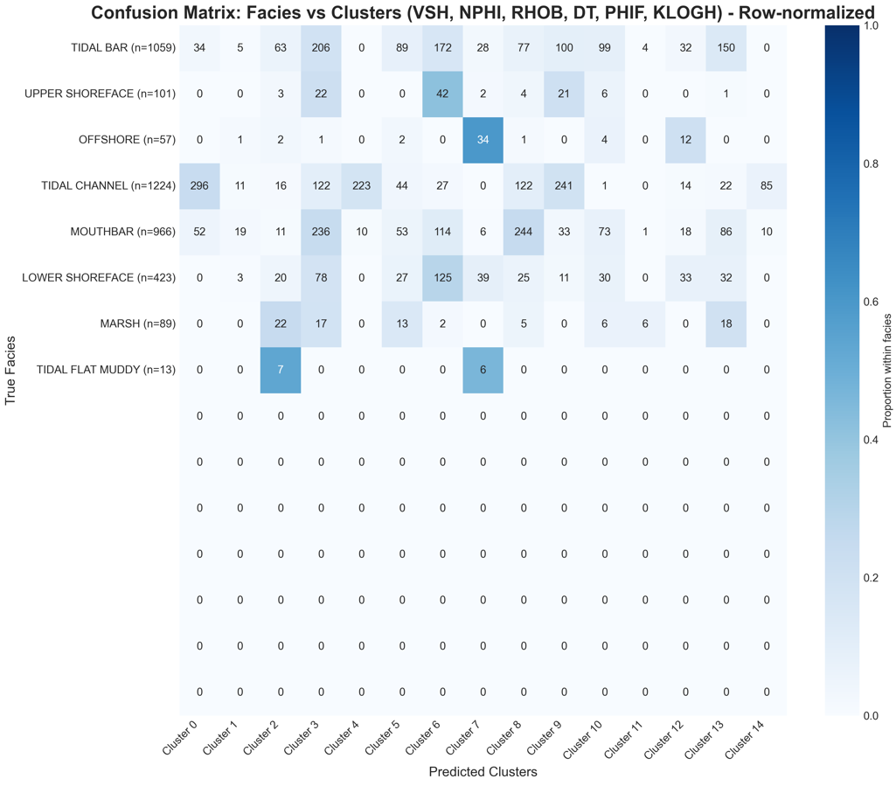
question 3 experiments result
Clusters are geologically interpretable at a coarse level: clean sand vs shaly separation.
On the confusion matrices for k = 2 one cluster concentrates most sand depo. facies (Tidal Bar, Tidal Channel, Mouth Bar, Upper Shoreface), while other captures shaly depo. facies (Offshore, Tidal Flat Muddy).
k = 15 splits coarse sand/shale into many small clusters but does not separate sand depo. facies.
k = 2, VSH, NPHI, RHOB, DT, PHIF, KLOGH
k = 15, VSH, NPHI, RHOB, DT, PHIF, KLOGH
41

Slide 42
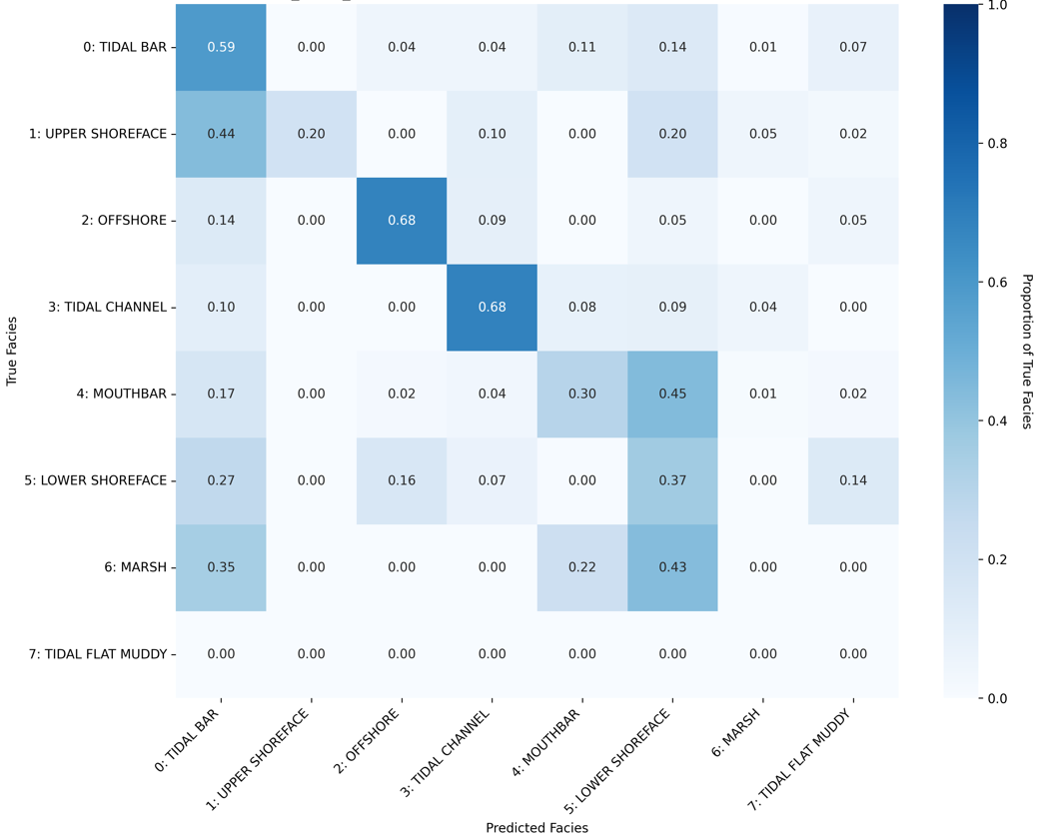
question 2 experiments result
All logs set Confusion matrix + Lithology
42

Slide 43
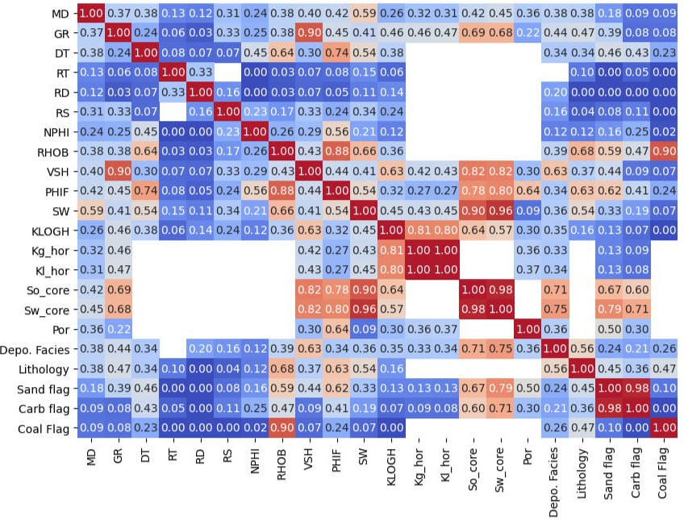
Phik correlation matrix
2

Slide 44
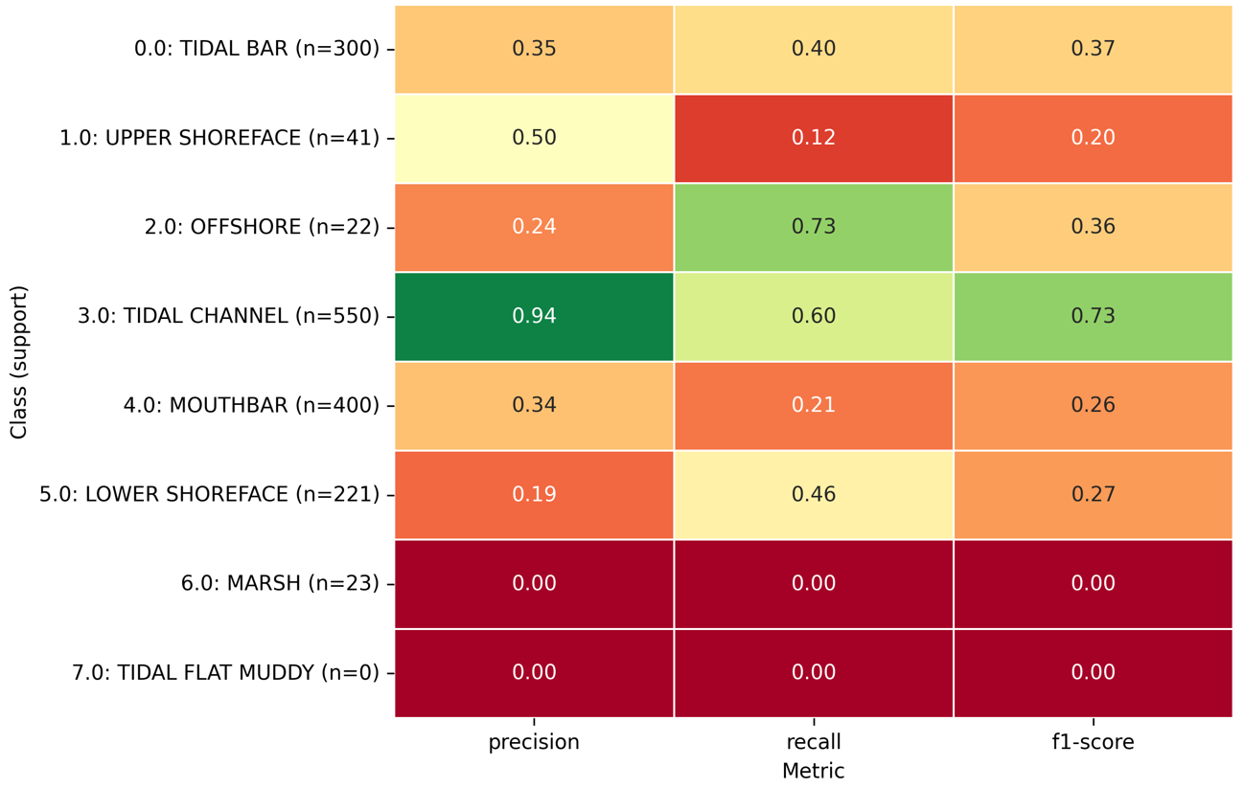
Question 1
Feature set: GR, VSH, RT, RD, NPHI, RHOB, DT, PHIF, SW, KLOGH

Slide 45
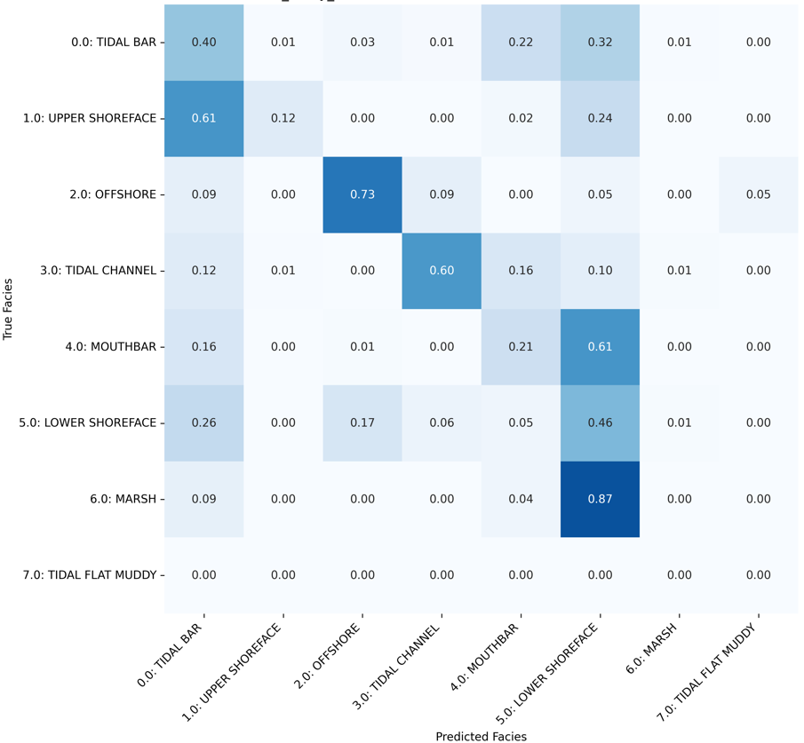
Question 1
Feature set: GR, VSH, RT, RD, NPHI, RHOB, DT, PHIF, SW, KLOGH

Slide 46
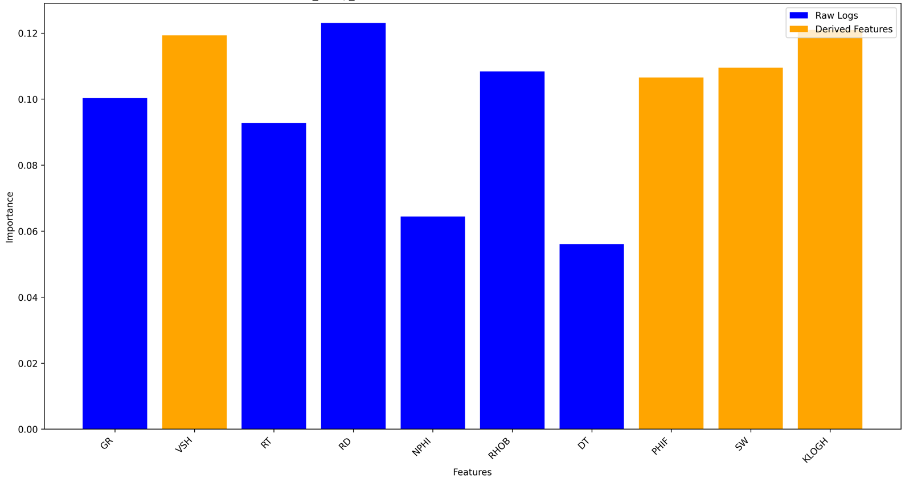
Question 1
Feature set: GR, VSH, RT, RD, NPHI, RHOB, DT, PHIF, SW, KLOGH

Slide 47
Question 1
Feature set: VSH, NPHI, RHOB, DT, PHIF, KLOGH
Four wells are available for this feature set
Well F-5 chosen as a test well because it is closest to the overall class mix
Available wells
Test well

Slide 48
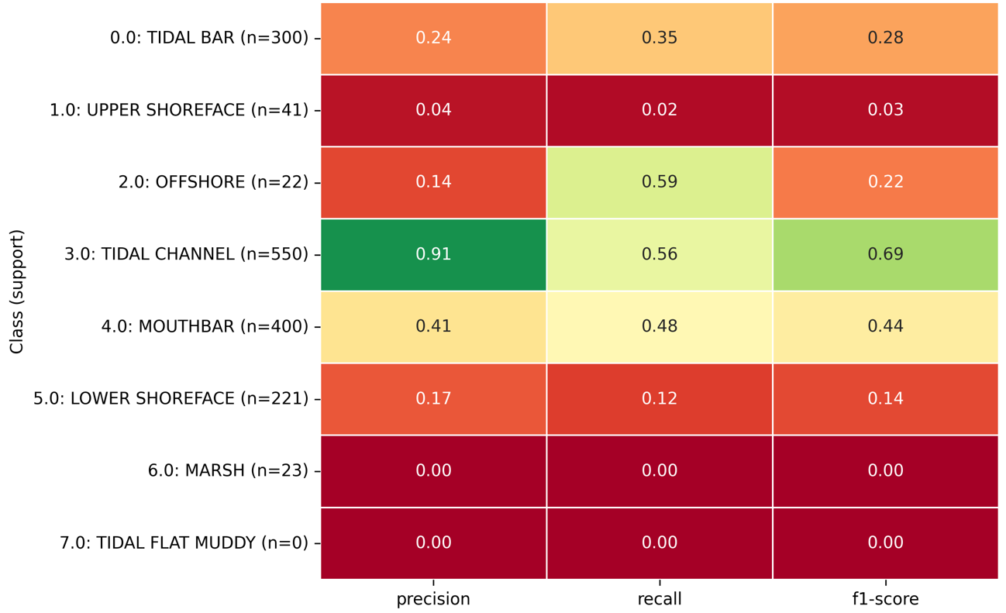
Question 1
Feature set: VSH, NPHI, RHOB, DT, PHIF, KLOGH

Slide 49
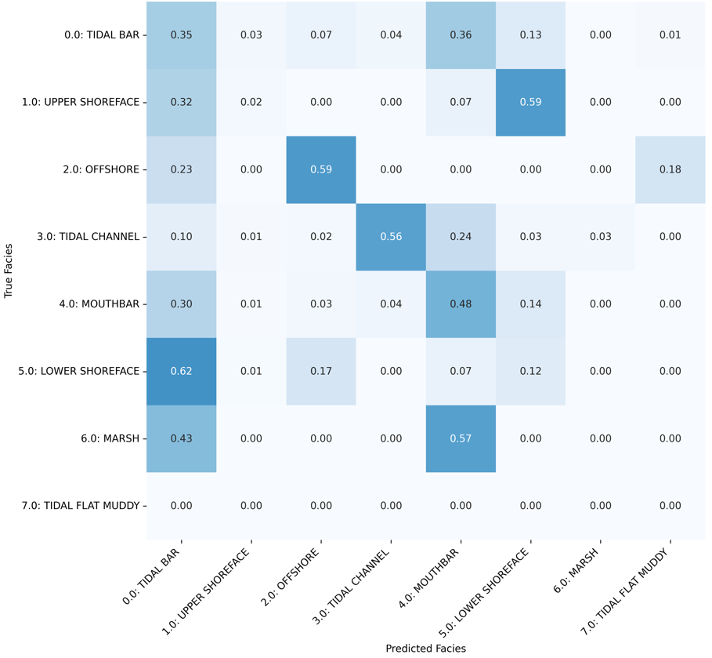
Question 1
Feature set: VSH, NPHI, RHOB, DT, PHIF, KLOGH

Slide 50
Question 1
Feature set: VSH, NPHI, RHOB, DT
Five wells are available for this feature set
Well F-5 chosen as a test well because it is closest to the overall class mix
Available wells
Available wells
Test well

Slide 51
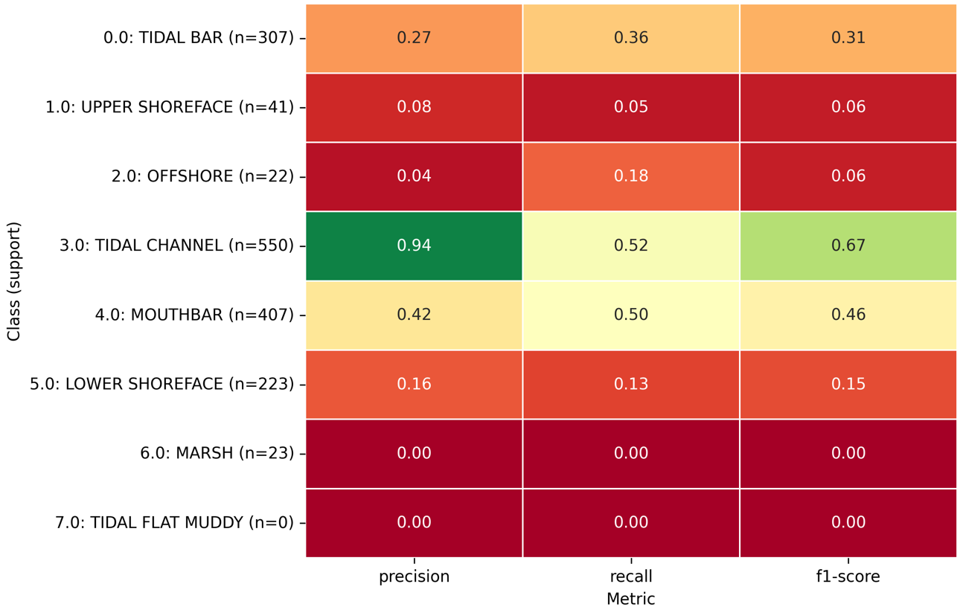
Question 1
Feature set: VSH, NPHI, RHOB, DT

Slide 52
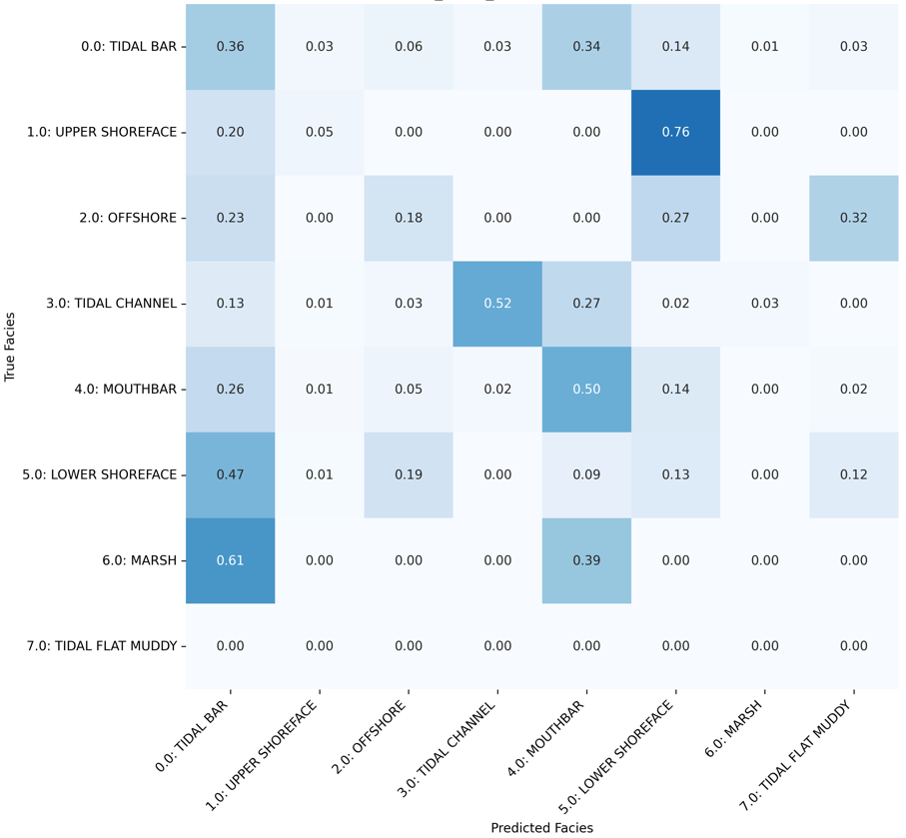
Question 1
Feature set: VSH, NPHI, RHOB, DT

Slide 53
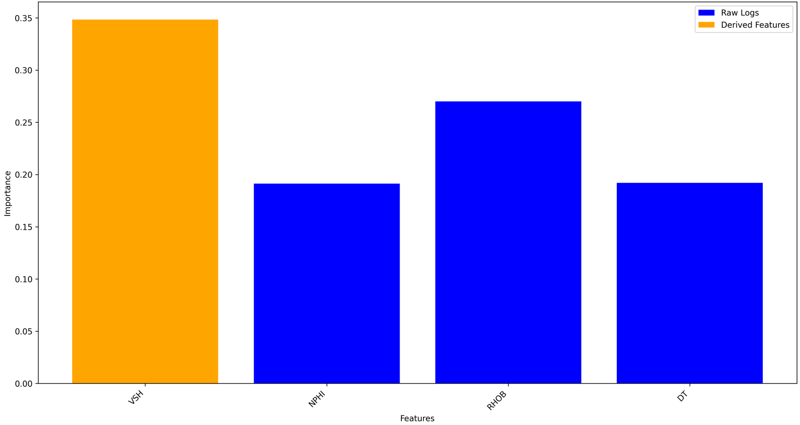
Question 1
Feature set: VSH, NPHI, RHOB, DT

Slide 54
Question 1
Feature set: VSH, PHIF, DT
Five wells are available for this feature set
Well F-5 chosen as a test well because it is closest to the overall class mix
Available wells
Available wells
Test well

Slide 55
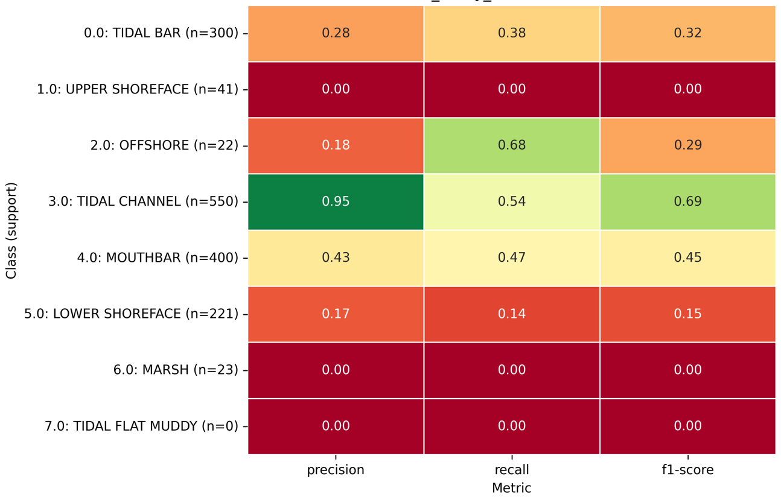
Question 1
Feature set: VSH, PHIF, DT

Slide 56
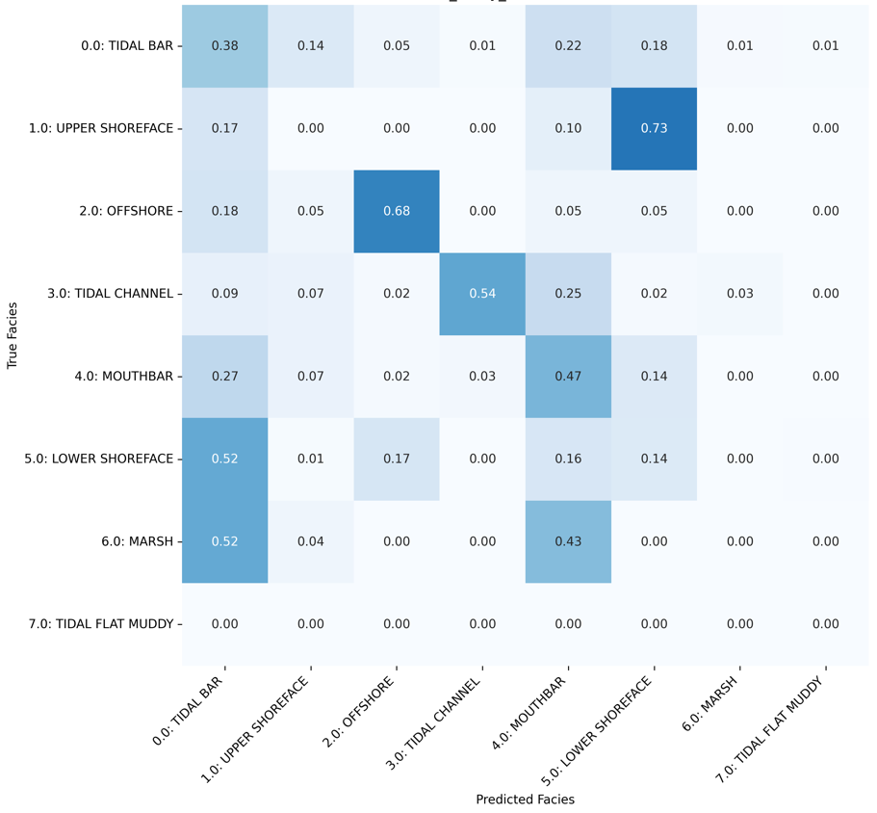
Question 1
Feature set: VSH, PHIF, DT

Slide 57
Question 1
Feature set: VSH, PHIF, SW, KLOGH
Five wells are available for this feature set
Well F-5 chosen as a test well because it is closest to the overall class mix (and a recorded problem with log distribution of F-12)
Available wells
Test well

Slide 58
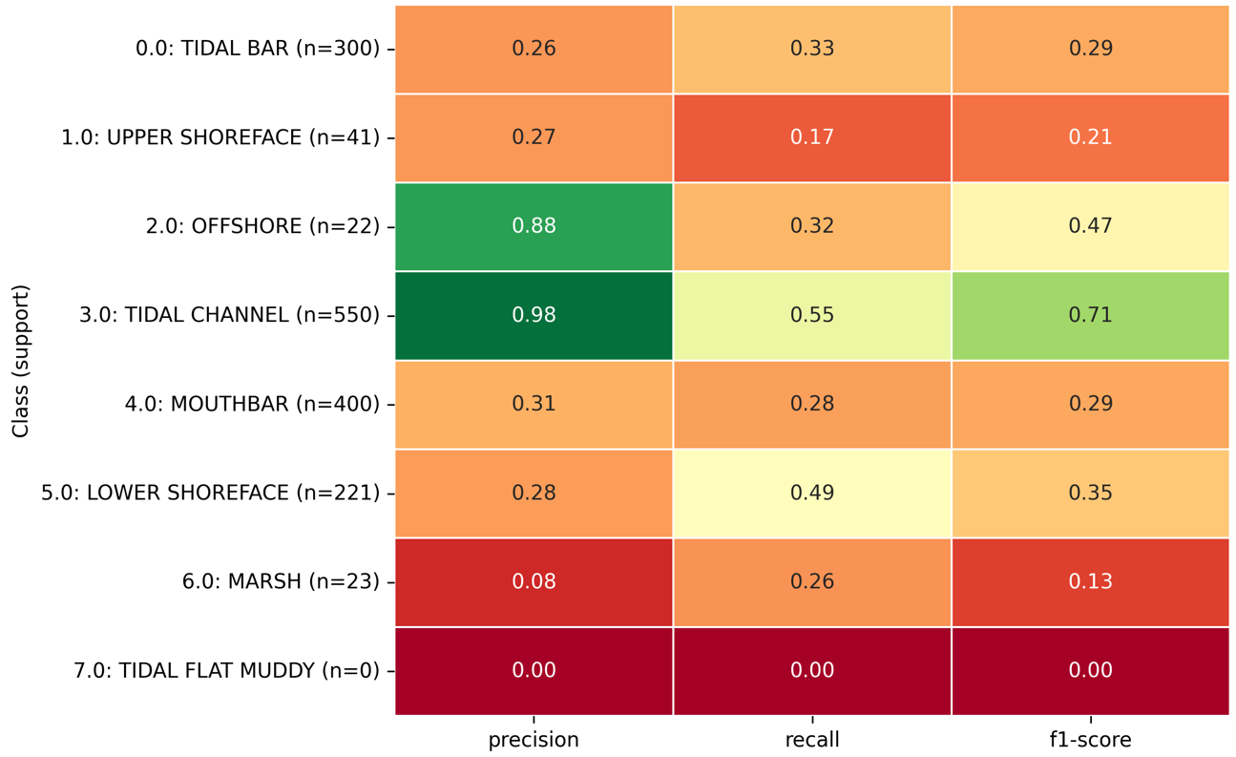
Question 1
Feature set: VSH, PHIF, SW, KLOGH

Slide 59
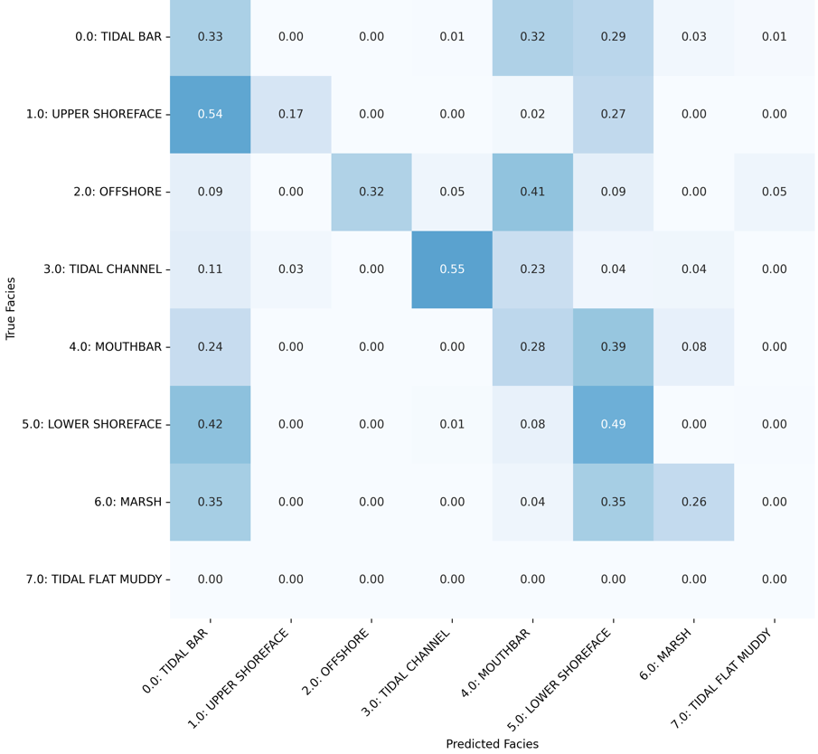
Question 1
Feature set: VSH, PHIF, SW, KLOGH

Slide 60
Question 1
Feature set: GR, NPHI, RHOB, DT
Five wells are available for this feature set
Well F-15C chosen as a test well because it is closest to the overall class mix (and a recorded problem with log distribution of F-12)
Available wells
Available wells
Test well

Slide 61
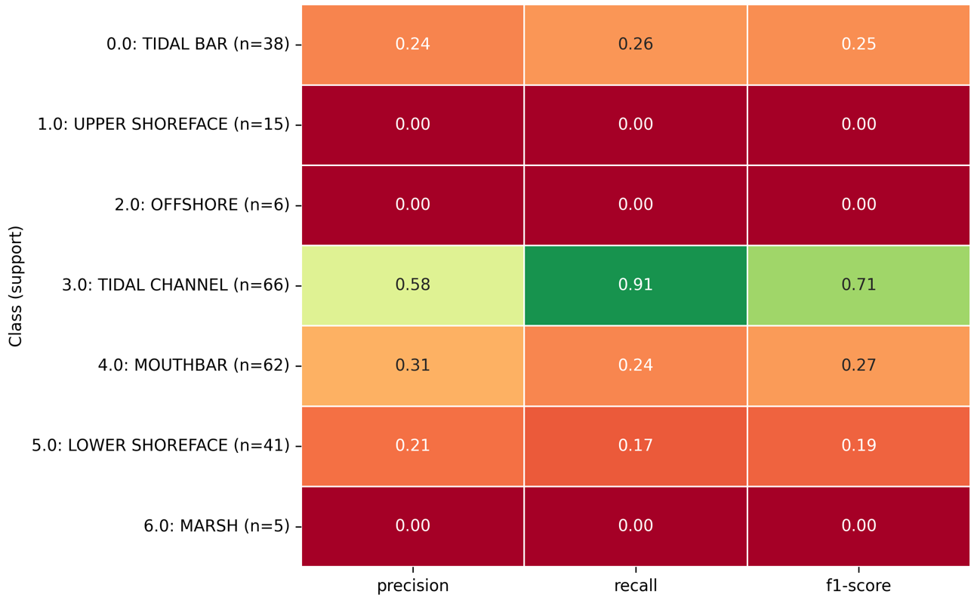
Question 1
Feature set: GR, NPHI, RHOB, DT

Slide 62
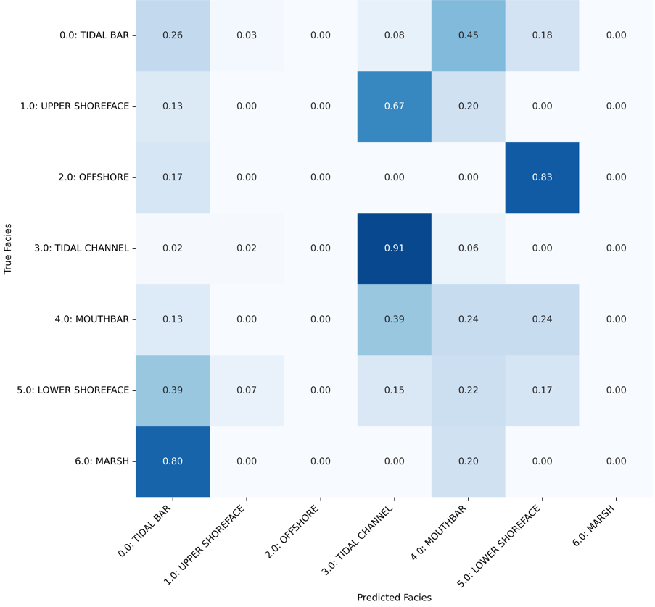
Question 1
Feature set: GR, NPHI, RHOB, DT

Slide 63
Question 1
Feature set: GR, NPHI, RHOB, DT, RT, RD
Five wells are available for this feature set
Well F-5 chosen as a test well because it is closest to the overall class mix (and a recorded problem with log distribution of F-12)
Available wells
Available wells
Test well

Slide 64
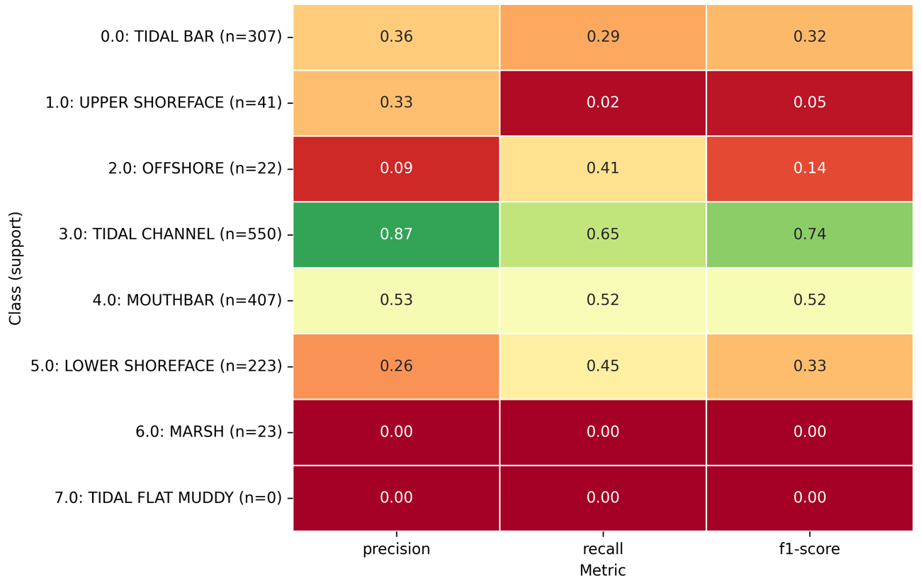
Question 1
Feature set: GR, NPHI, RHOB, DT, RT, RD

Slide 65
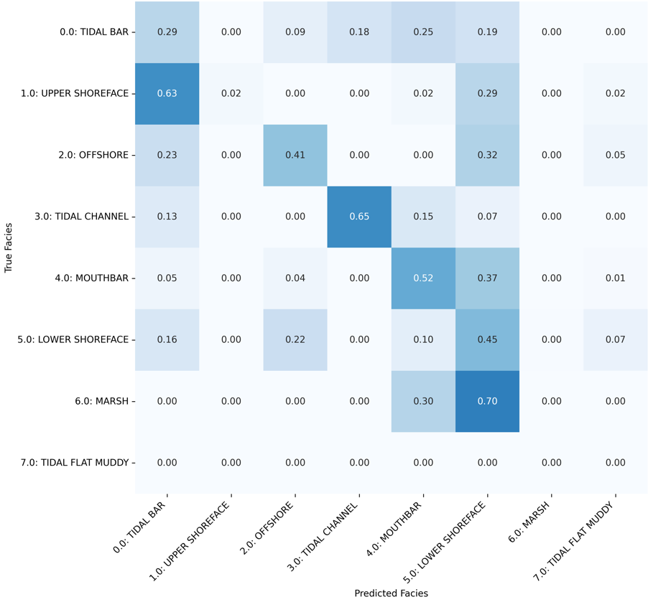
Question 1
Feature set: GR, NPHI, RHOB, DT, RT, RD

Slide 66
Question 1
Feature set: DT, RHOB, NPHI
Five wells are available for this feature set
Well F-5 chosen as a test well because it is closest to the overall class mix (and a recorded problem with log distribution of F-12)
Available wells
Available wells
Test well

Slide 67
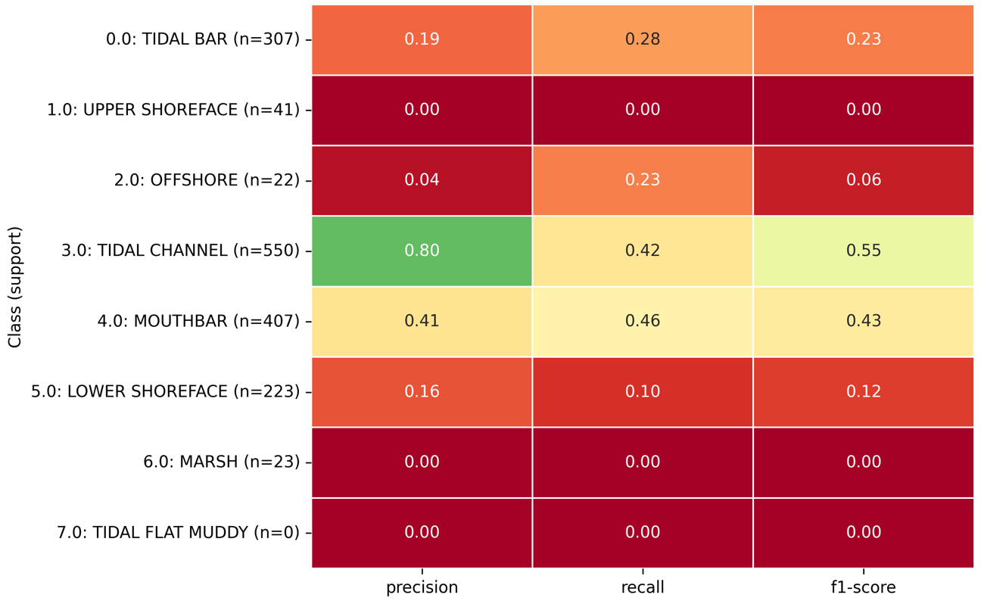
Question 1
Feature set: DT, RHOB, NPHI

Slide 68
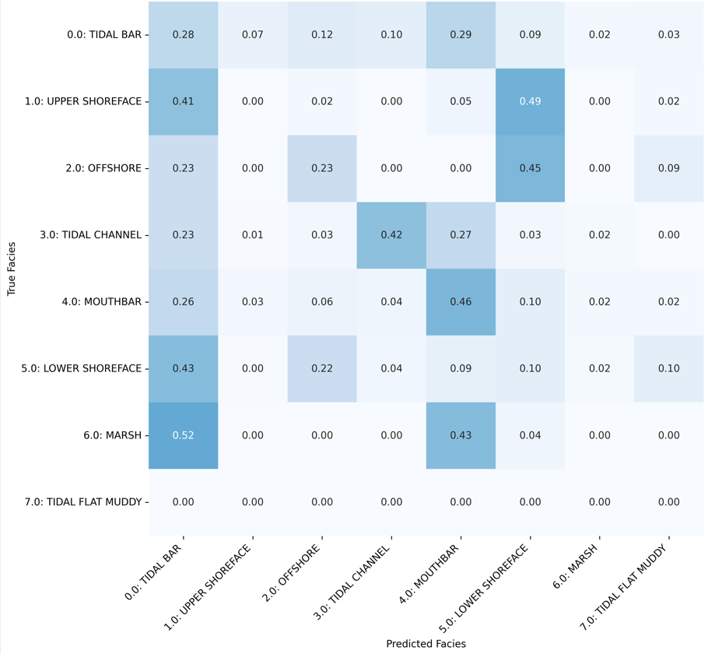
Question 1
Feature set: DT, RHOB, NPHI

Slide 69
Question 1
Feature set: GR, VSH, NPHI, RHOB, DT, PHIF, KLOGH
Four wells are available for this feature set
Well F-5 chosen as a test well because it is closest to the overall class mix
Available wells
Test well

Slide 70
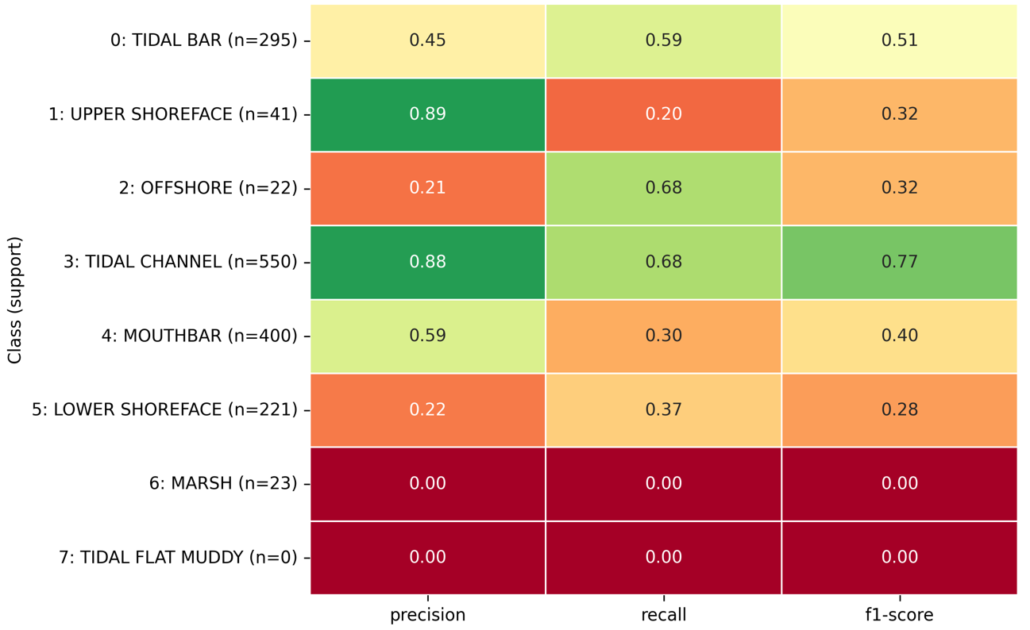
Question 2
Feature set: GR, VSH, RT, RD, NPHI, RHOB, DT, PHIF, SW, KLOGH + lithology

Slide 71
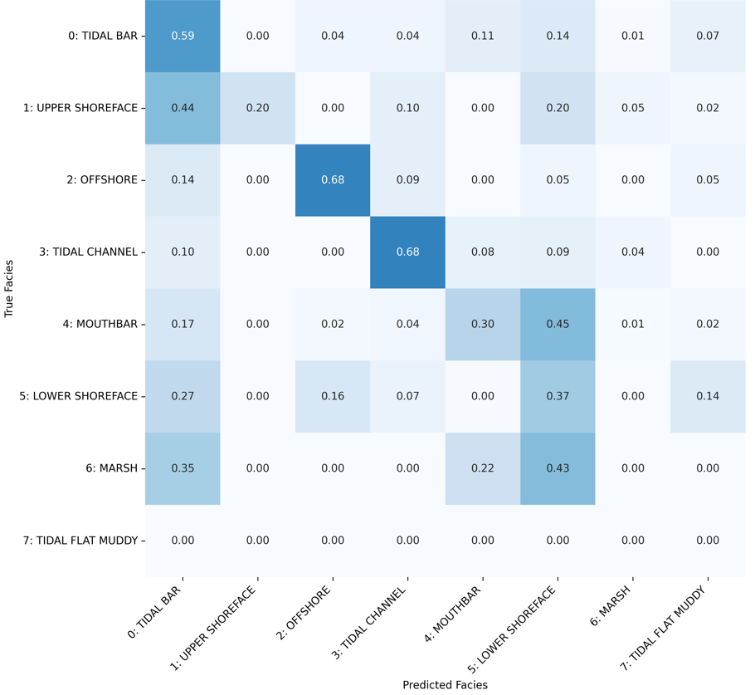
Question 2
Feature set: GR, VSH, RT, RD, NPHI, RHOB, DT, PHIF, SW, KLOGH + lithology

Slide 72
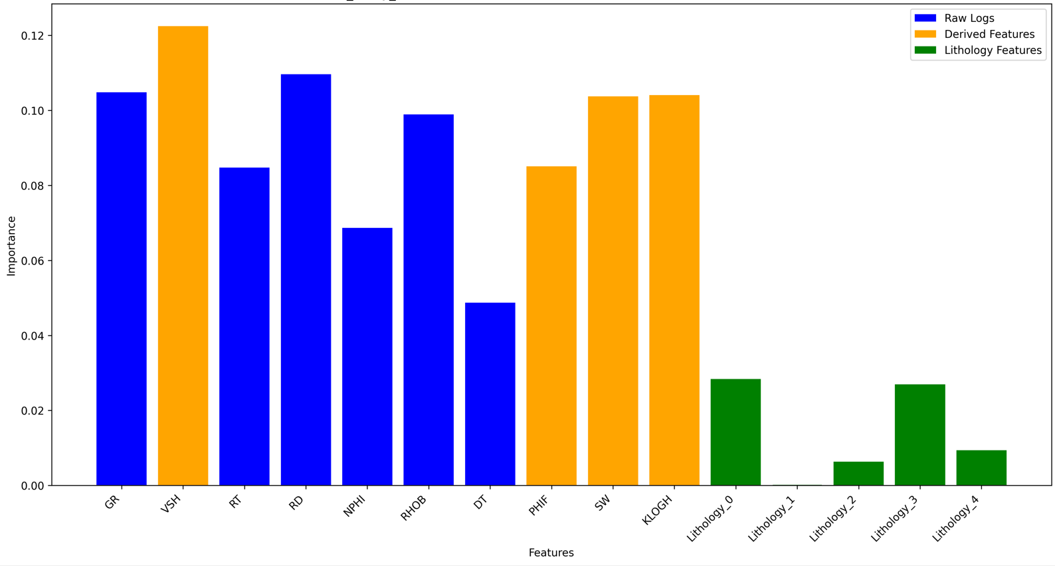
Question 2
Feature set: GR, VSH, RT, RD, NPHI, RHOB, DT, PHIF, SW, KLOGH + lithology

Slide 73
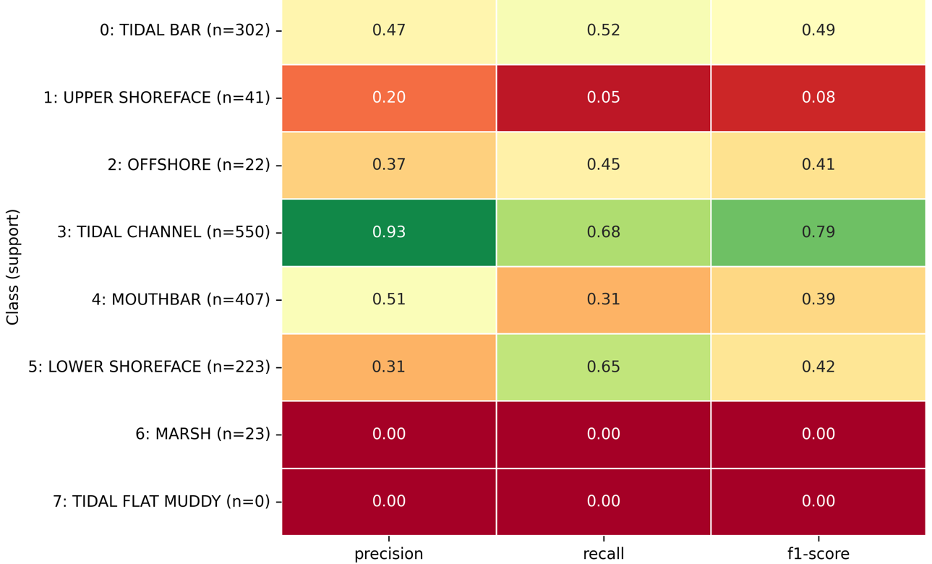
Question 2
Feature set: GR, NPHI, RHOB, DT (plus RT, RD) + Lithology

Slide 74
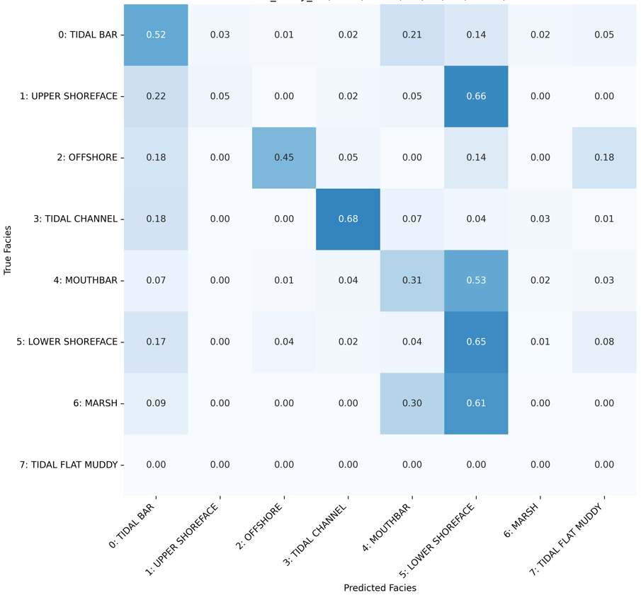
Question 2
Feature set: GR, NPHI, RHOB, DT (plus RT, RD) + Lithology

Slide 75
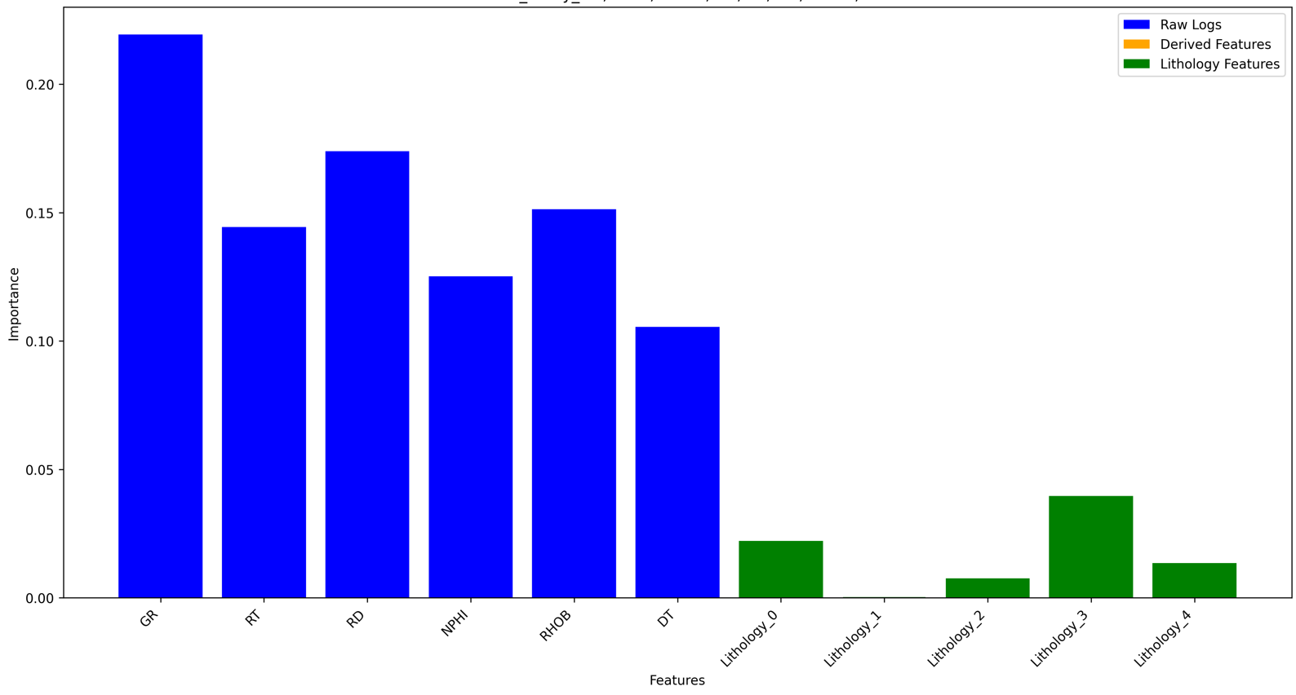
Question 2
Feature set: GR, NPHI, RHOB, DT (plus RT, RD) + Lithology

Slide 76
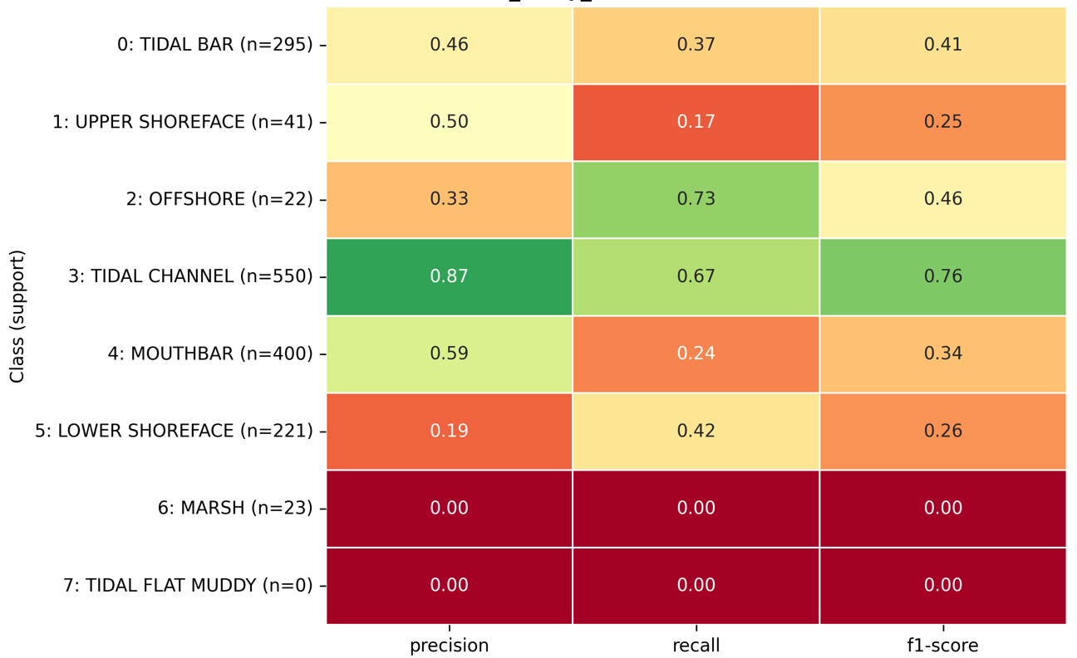
Question 2
Feature set: VSH, PHIF, SW, KLOGH

Slide 77
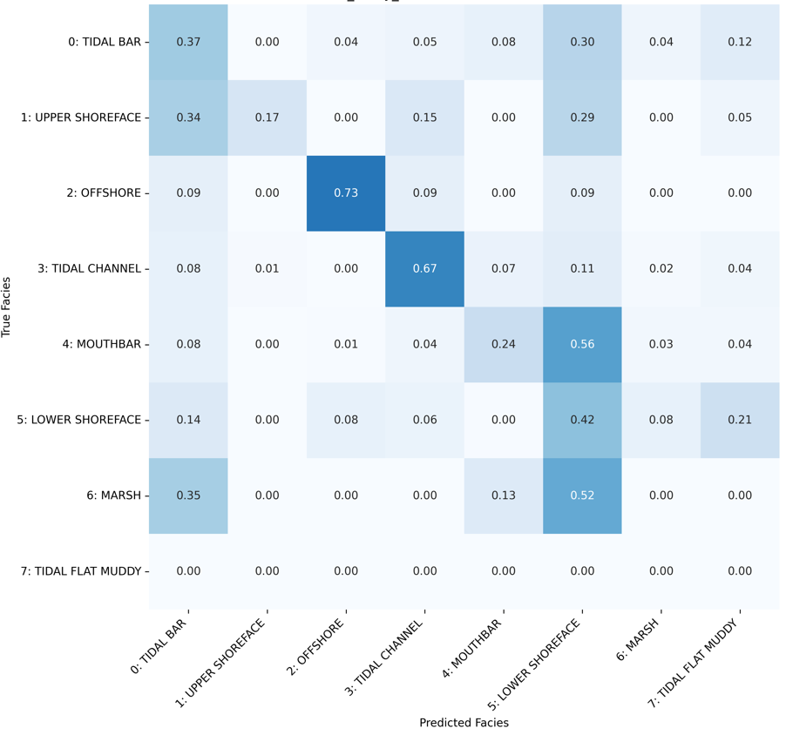
Question 2
Feature set: VSH, PHIF, SW, KLOGH

Slide 78

Question 2
Feature set: VSH, PHIF, SW, KLOGH

Slide 79

Question 2
Feature set: VSH, PHIF, DT

Slide 80

Question 2
Feature set: VSH, PHIF, DT

Slide 81
question 3
Does adding engineered features help?
+ Engineered features:
GR slope: d(GR)/dz in 3.5 m window to capture coarsening up (Mouth Bar) vs fining up (Tidal Bar, Tidal Channel)
Script implementation
For each well:
Sort data by depth
For each depth point:
Define window boundaries (±1.75m from current point)
Find all points within window
If ≥3 points available:
Perform linear regression (least squares regression)
Extract slope coefficient (d(GR)/dz)

Slide 82

question 3
Feature set: GR, VSH, RT, RD, NPHI, RHOB, DT, PHIF, SW, KLOGH
+ Engineered features:
GR slope: d(GR)/dz in 3.5 m window to capture coarsening up (Mouth Bar) vs fining up (Tidal Bar, Tidal Channel)
Without the GR slope feature
With GR slope feature

Slide 83

question 3
Feature set: GR, VSH, RT, RD, NPHI, RHOB, DT, PHIF, SW, KLOGH
+ Engineered features:
GR slope: d(GR)/dz in 3.5 m window to capture coarsening up (Mouth Bar) vs fining up (Tidal Bar, Tidal Channel)

Slide 84
question 3
Does adding engineered features help?
+ Engineered features:
GR serration: rolling std (GR) in 3m window because it is higher in heteroliths/mud-draped tidal bars, lower in blocky channels
Script implementation
For each well:
Sort data by depth
For each depth point:
Define window boundaries (±1.5m from current point)
Find all points within window
Create paired arrays
Calculate means
Calculate slope with least squares formula

Slide 85

question 3
Feature set: GR, VSH, RT, RD, NPHI, RHOB, DT, PHIF, SW, KLOGH
+ Engineered features:
GR serration: rolling std (GR) in 3m window because it is higher in heteroliths/mud-draped tidal bars, lower in blocky channels
Without the GR serration feature
With GR serration feature

Slide 86

question 3
Feature set: GR, VSH, RT, RD, NPHI, RHOB, DT, PHIF, SW, KLOGH
+ Engineered features:
GR serration: rolling std (GR) in 3m window because it is higher in heteroliths/mud-draped tidal bars, lower in blocky channels

Slide 87

question 3

Slide 88
question 3
Does adding engineered features help?
+ Engineered features:
Relpos: relative position in GR-cycle to help distinguish sands in regressive-transgressive cycles
Script implementation
For each well:
Sort data by depth
Extract depth and GR arrays
Apply GR curve smoothing
Find turning points
Define cycles
Calculate RelPos for each cycle: RelPos = (GR_start - GR_current) / (GR_start - GR_end)

Slide 89

question 3
Feature set: GR, VSH, RT, RD, NPHI, RHOB, DT, PHIF, SW, KLOGH
+ Engineered features:
Relpos: relative position in GR-cycle to help distinguish sands in regressive-transgressive cycles
Without Relpos
With Relpos

Slide 90

question 3
Feature set: GR, VSH, RT, RD, NPHI, RHOB, DT, PHIF, SW, KLOGH
+ Engineered features:
Relpos: relative position in GR-cycle to help distinguish sands in regressive-transgressive cycles

Slide 91


Normalized values

Slide 92

Normalized values

